Slide 1
WORLD Health, eDUCATION and economy data visualization A web Scraping project
Mengran Jessie Cui
NYC Data Science Academy
July 8, 2019

Slide 2
AGENDA
01
Introduction
02
Web Scraping
03
Topic 1: People and Health
04
Topic 2: Education, Communication and Economy
05
Conclusion and Wrap Up
Notes:
© Copyright Showeet.com

Slide 3
AGENDA
01
Introduction
02
Web Scraping
03
Topic 1: People and Health
04
Topic 2: Education, Communication and Economy
05
Conclusion and Wrap Up
Notes:
© Copyright Showeet.com

Slide 4

Introduction
Geography
Transportation
Military and Security
People and Society
Energy
Communication
Economy
Government
Education
……

Slide 5
Introduction
Geography
Transportation
Military and Security
People and Society
Energy
Communication
Economy
Government
Education
……

Slide 6
AGENDA
01
Introduction
02
Web Scraping
03
Topic 1: People and Health
04
Topic 2: Education, Communication and Economy
05
Conclusion and Wrap Up
Notes:
© Copyright Showeet.com

Slide 7
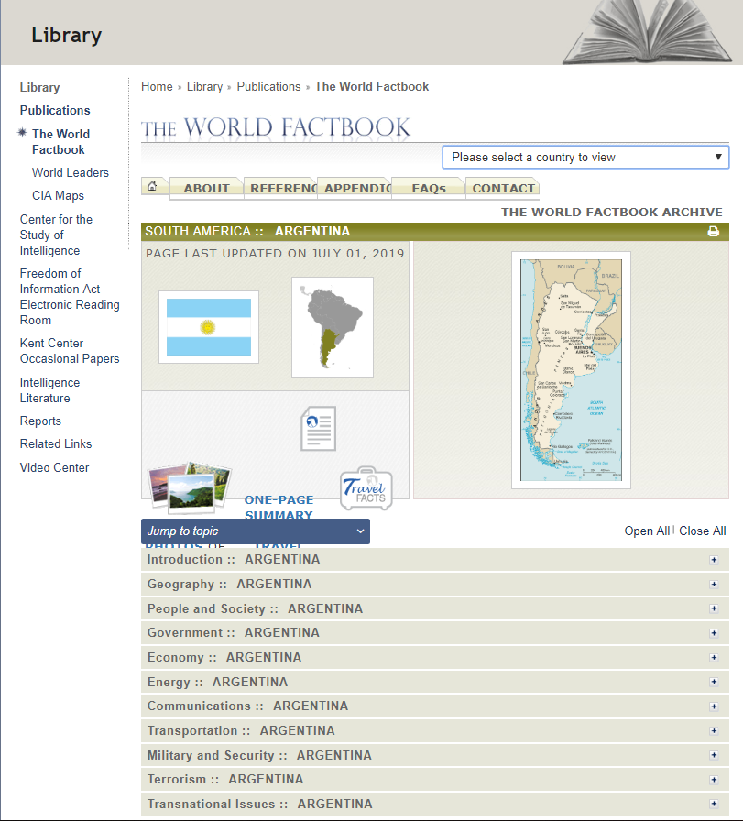
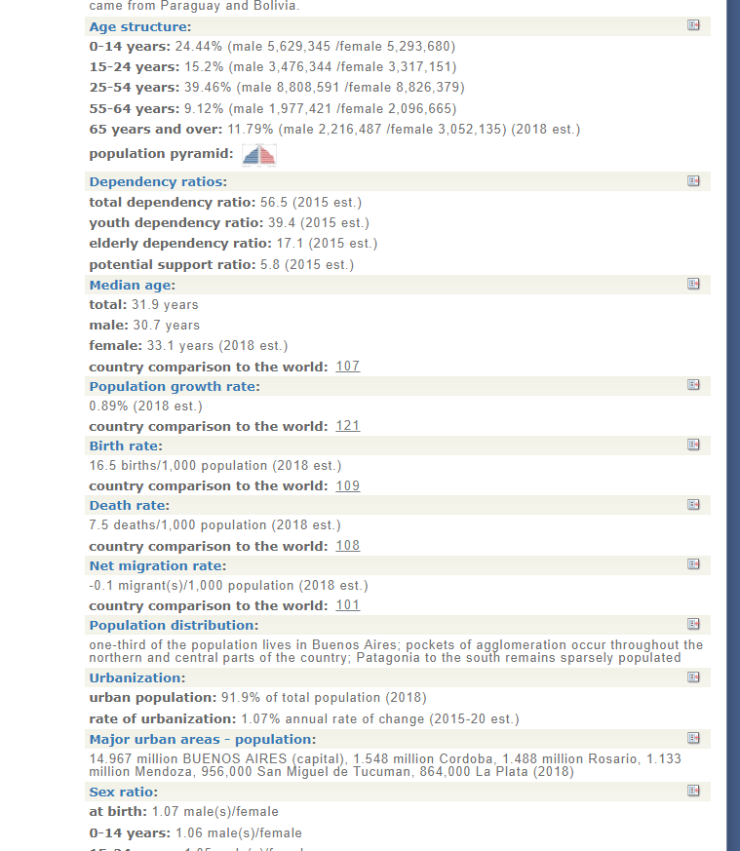
WEB SCRAPING

Slide 8
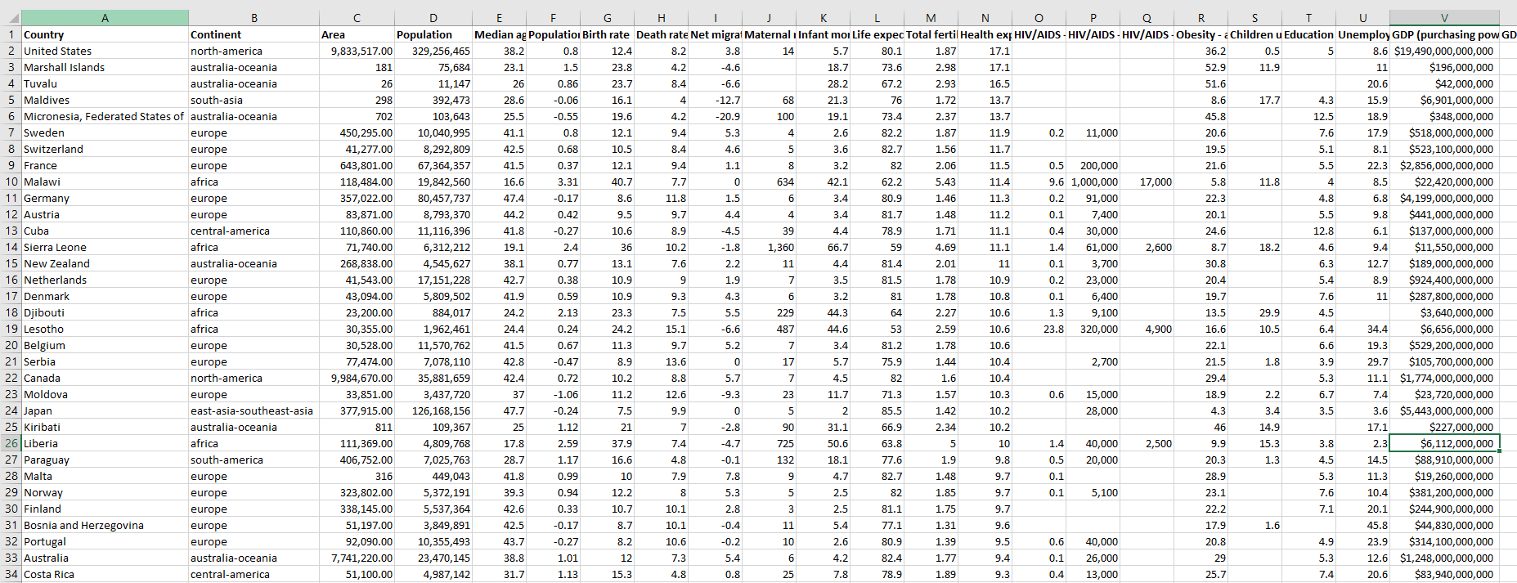



+
WEB SCRAPING
→
258 countries,78 attributes
Data visualization

Slide 9
AGENDA
01
Introduction
02
Web Scraping
03
Topic 1: People and Health
04
Topic 2: Education, Communication and Economy
05
Conclusion and Wrap Up
Notes:
© Copyright Showeet.com

Slide 10
People and Health
01
02
03
Mortality
Life expectancy and aging
HIV/AIDS
Maternal mortality rate
Infant mortality rate
Life expectancy at birth
Population growth rate
Median age
Total fertility rate
HIV/AIDS adult prevalence rate
04
05
The question: Does higher health expenditure necessarily help solving these 8 areas of health concern/problems?
Health expenditure
Health expenditure by $
Health expenditure by % of GDP
Maternal mortality
Infant mortality
Life expectancy at birth
Median age
Total fertility rate
HIV/AIDS adult prevalence rate
Obesity - adult prevalence rate
Children under the age of 5 years underweight

Slide 11
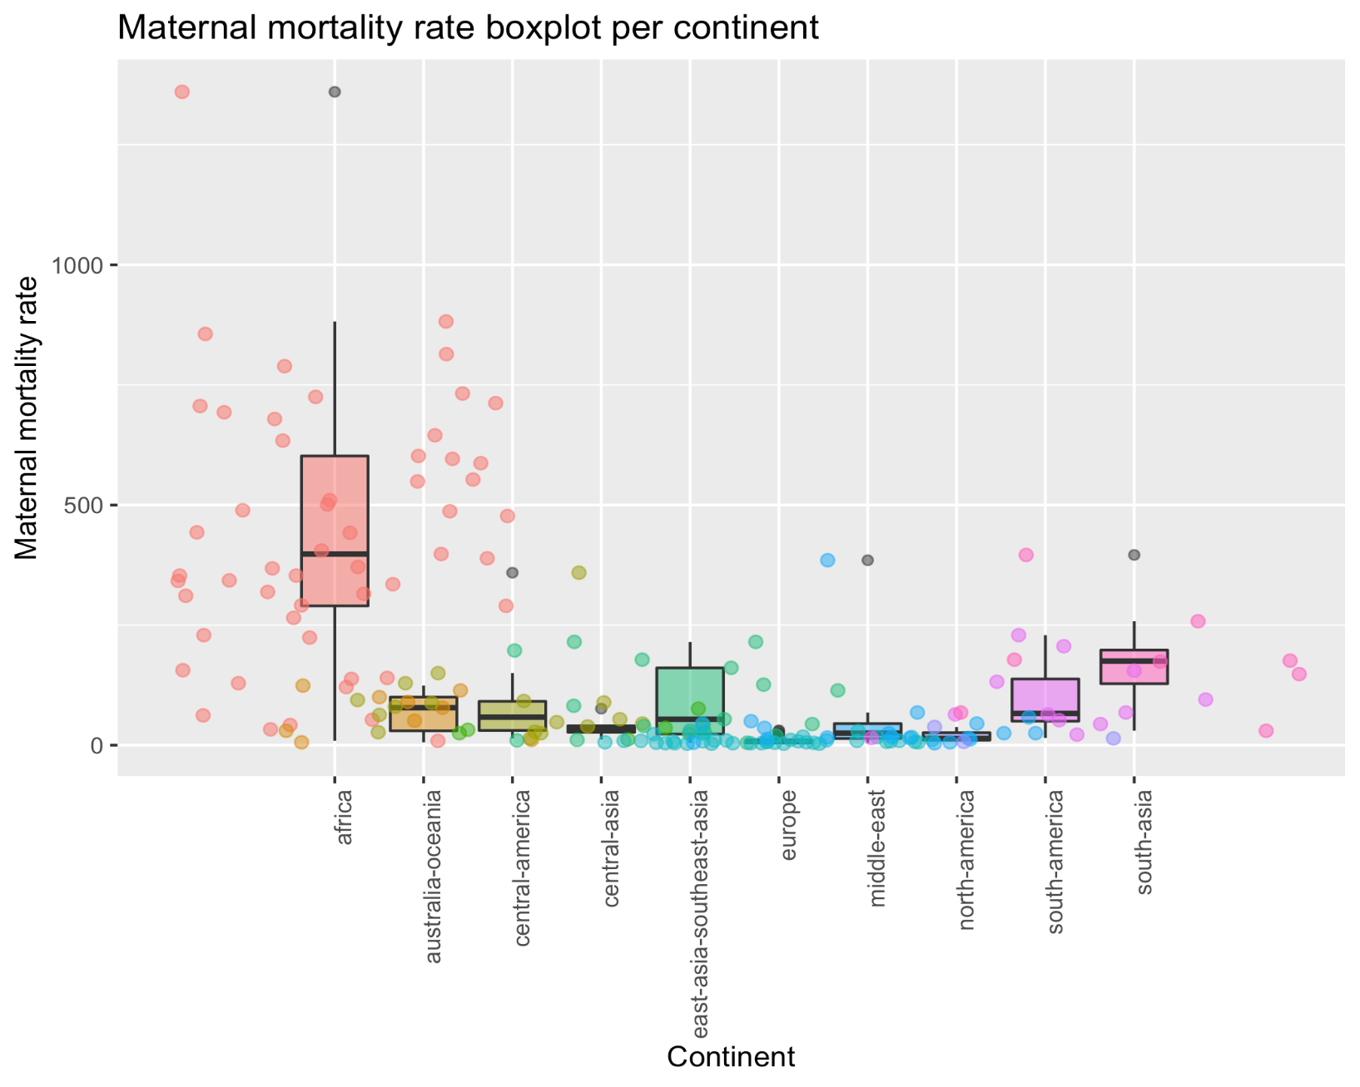
Maternal mortality
MMR is the annual number of female deaths per 100,000 live births from any cause related to or aggravated by pregnancy or its management (excluding accidental or incidental causes).
01
Mortality

Slide 12
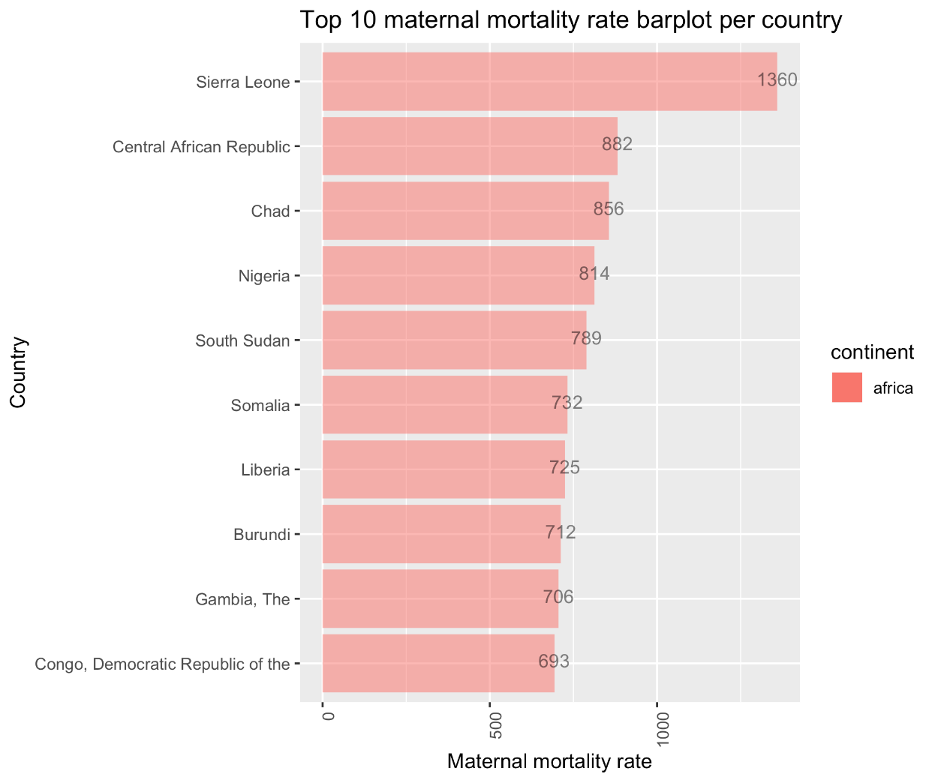
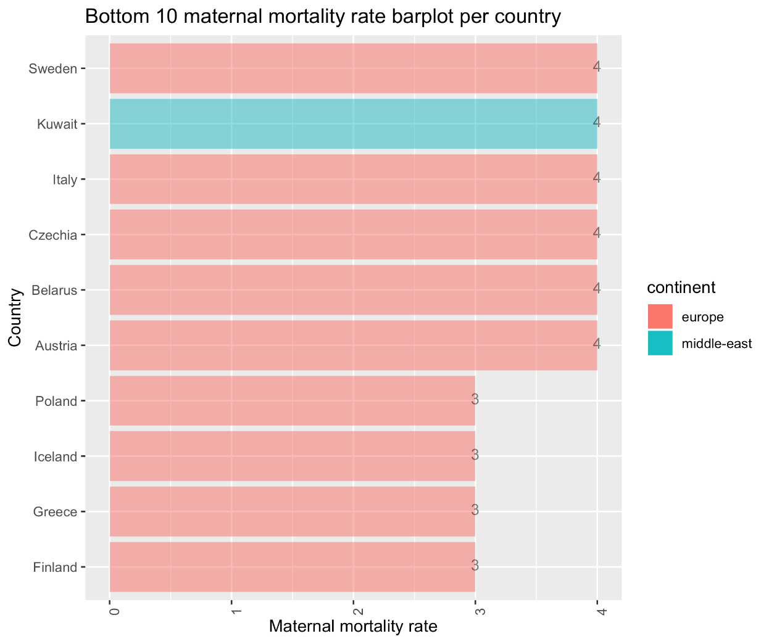
Maternal mortality
MMR is the annual number of female deaths per 100,000 live births from any cause related to or aggravated by pregnancy or its management (excluding accidental or incidental causes).
01
Mortality

Slide 13
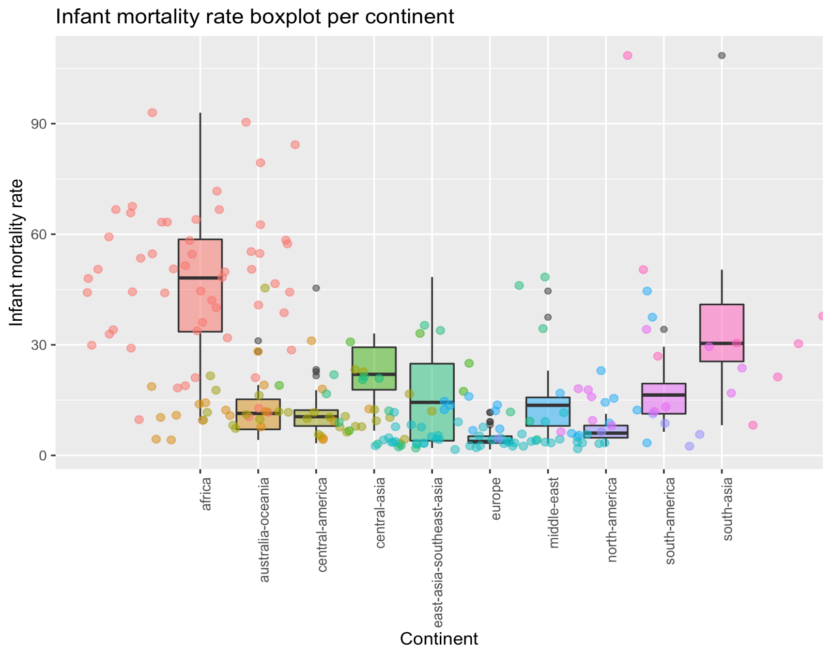
Infant mortality
Infant mortality rate compares the number of deaths of infants under one year old in a given year per 1,000 live births in the same year. This rate is often used as an indicator of the level of health in a country.
01
Mortality

Slide 14
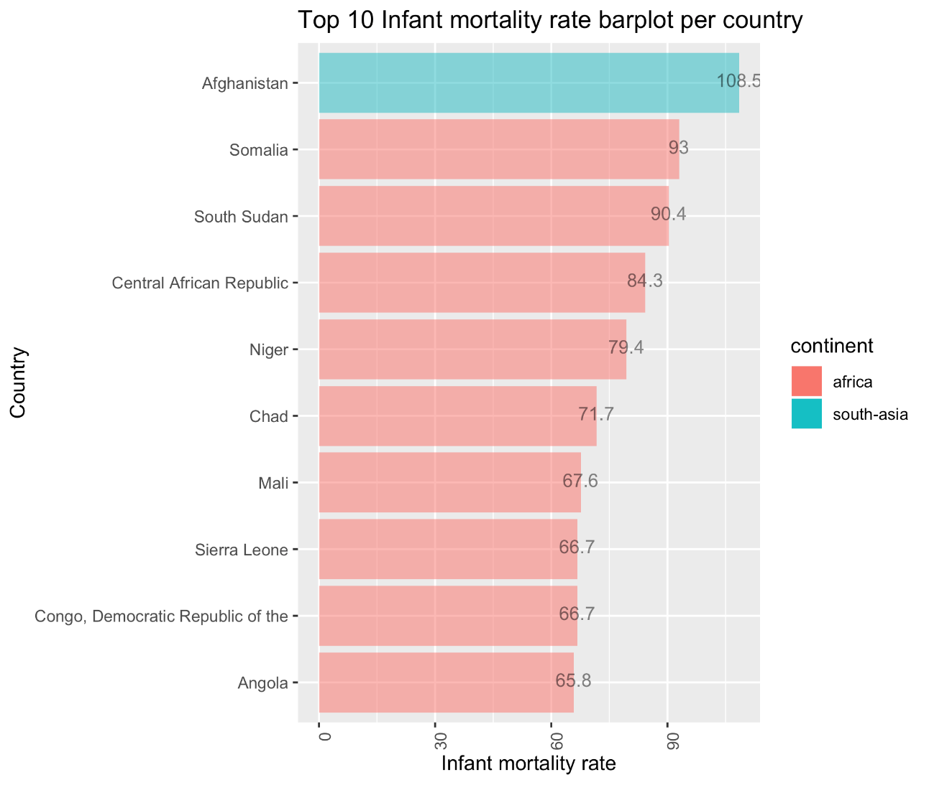
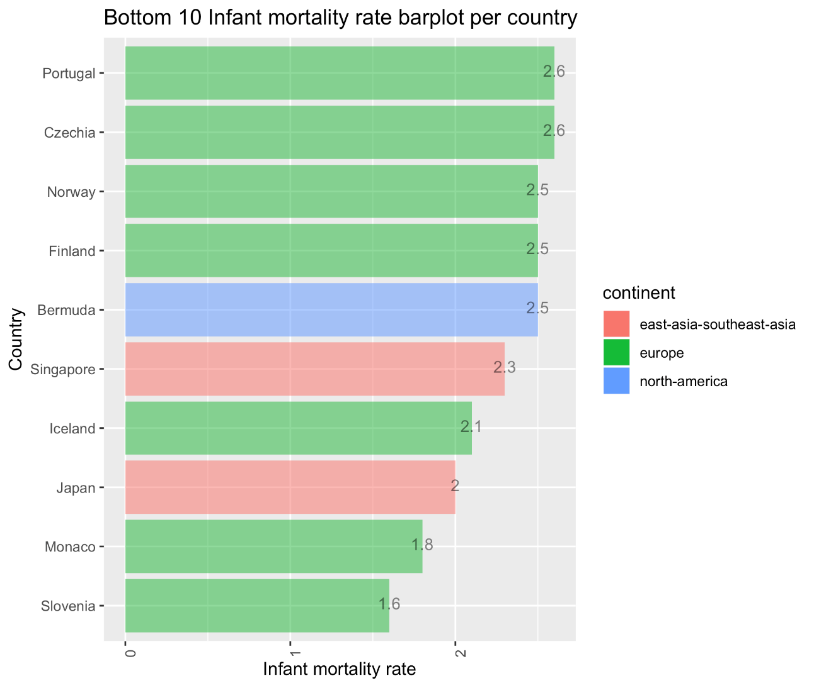
Infant mortality
Infant mortality rate compares the number of deaths of infants under one year old in a given year per 1,000 live births in the same year. This rate is often used as an indicator of the level of health in a country.
01
Mortality

Slide 15
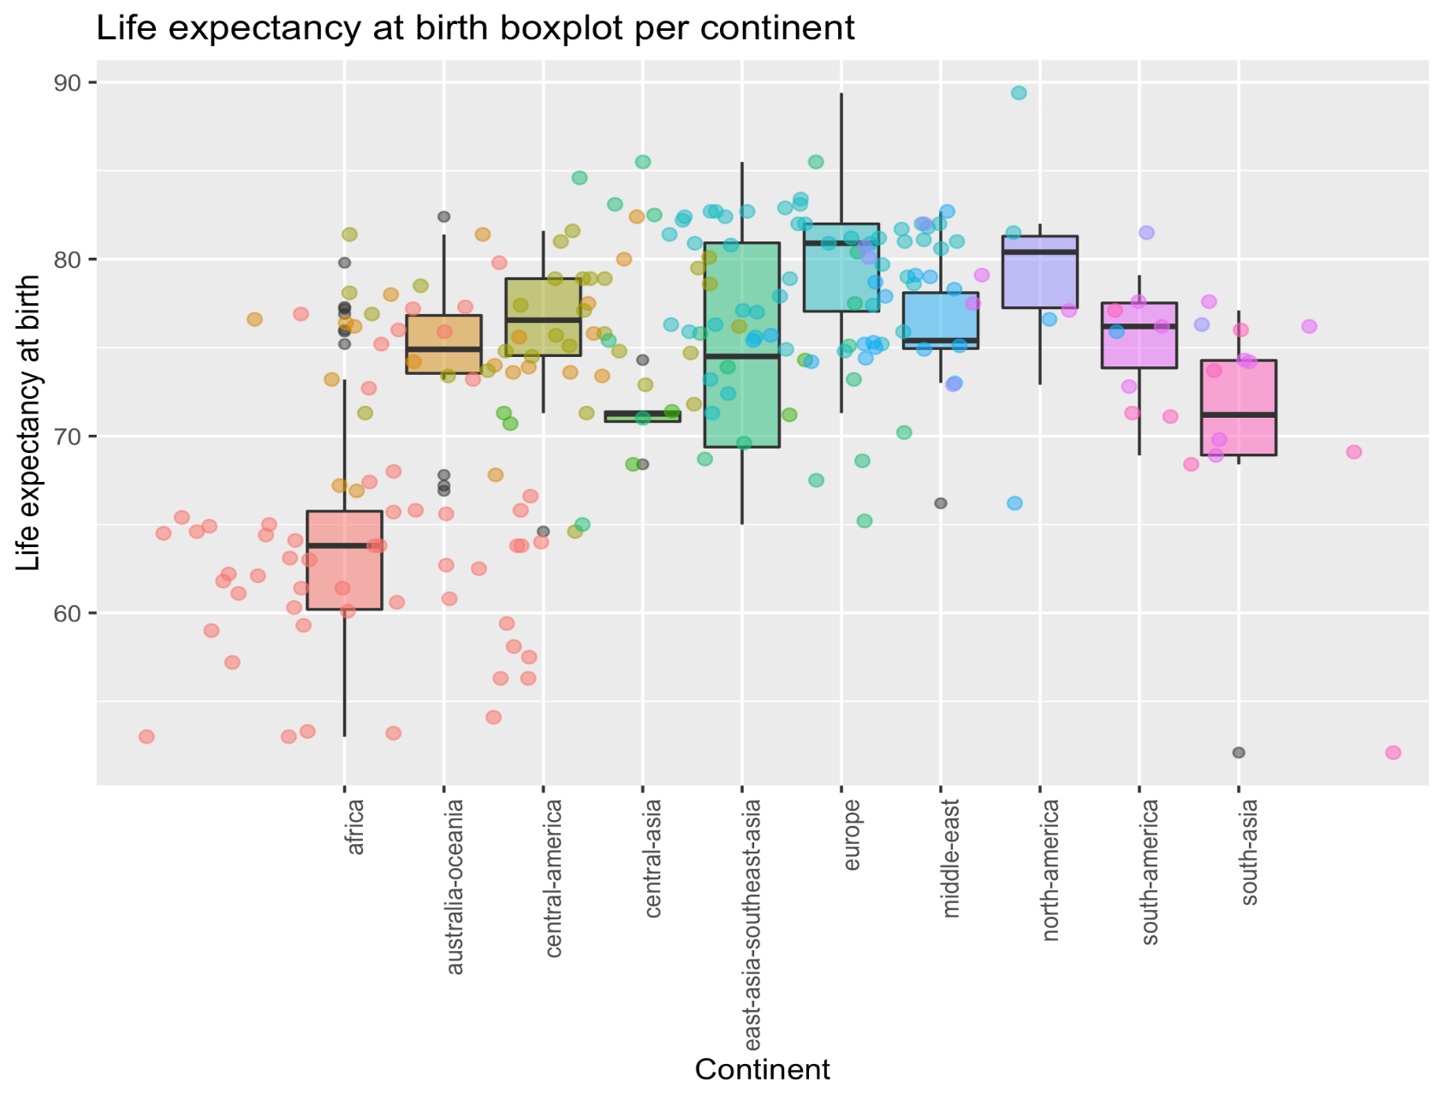
Life expectancy
Life expectancy at birth compares the average number of years to be lived by a group of people born in the same year, if mortality at each age remains constant in the future. Life expectancy at birth is also a measure of overall quality of life in a country and summarizes the mortality at all ages.
02
Life & aging

Slide 16
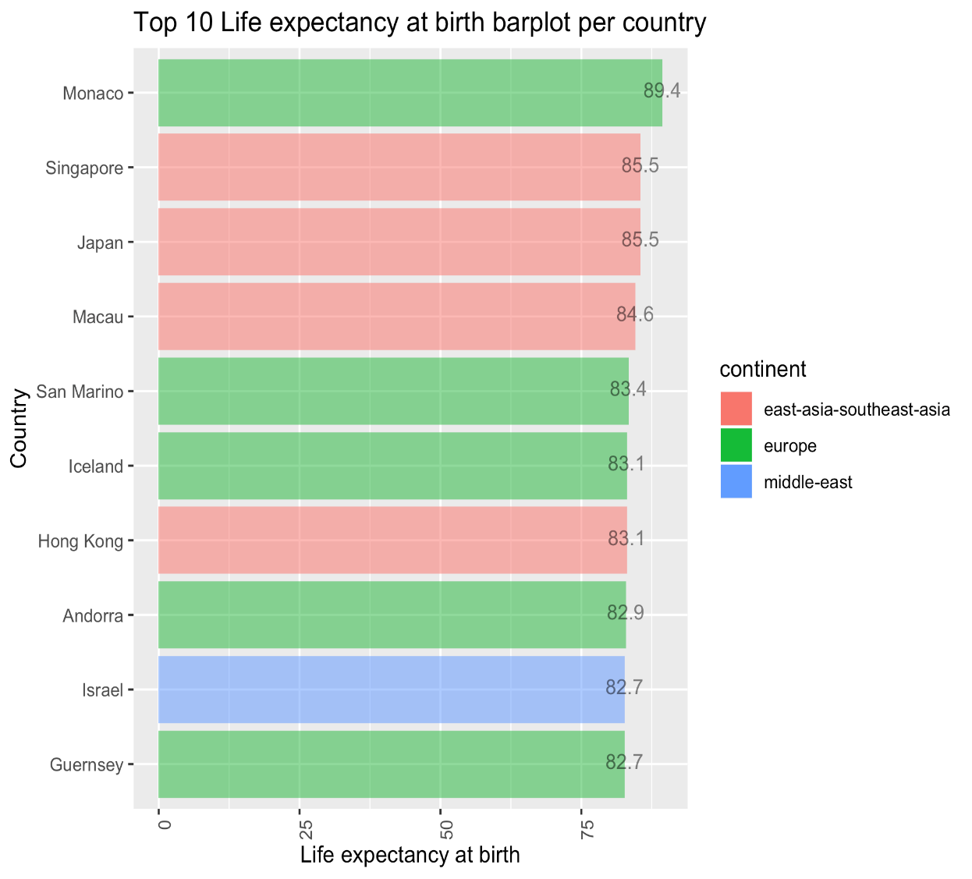
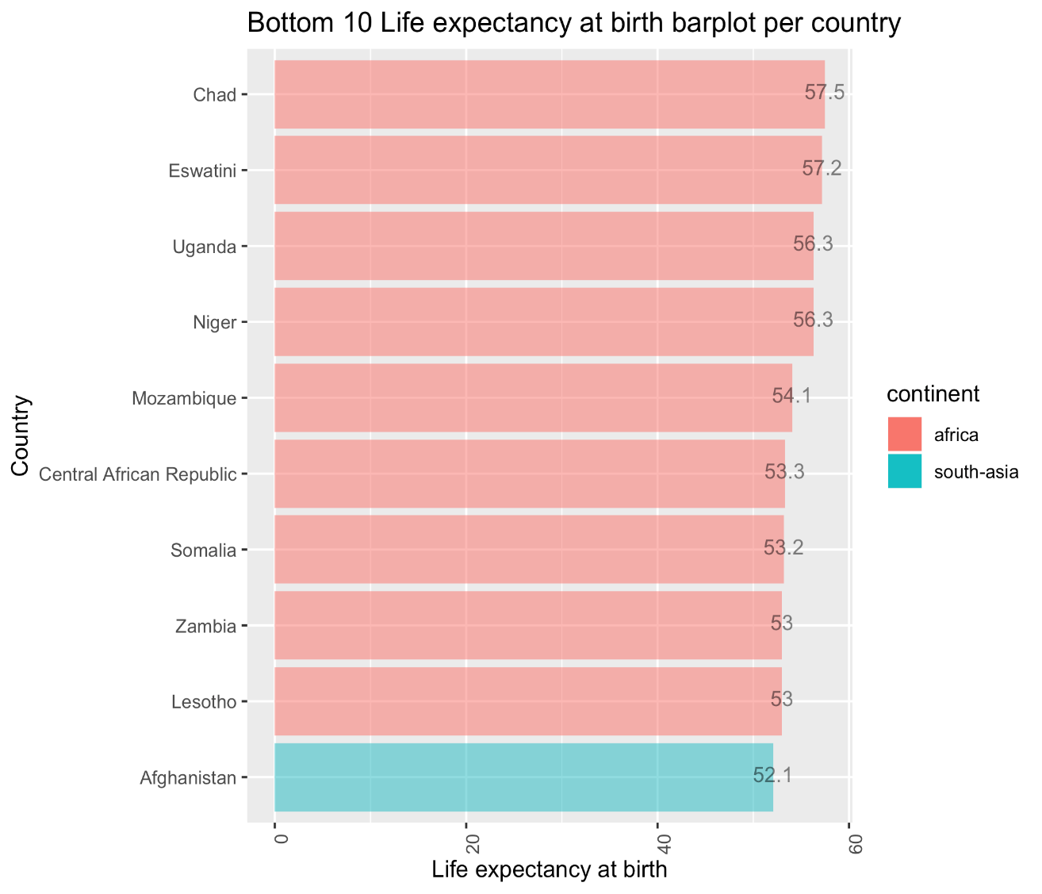
Life expectancy
Life expectancy at birth compares the average number of years to be lived by a group of people born in the same year, if mortality at each age remains constant in the future. Life expectancy at birth is also a measure of overall quality of life in a country and summarizes the mortality at all ages.
02
Life & aging

Slide 17
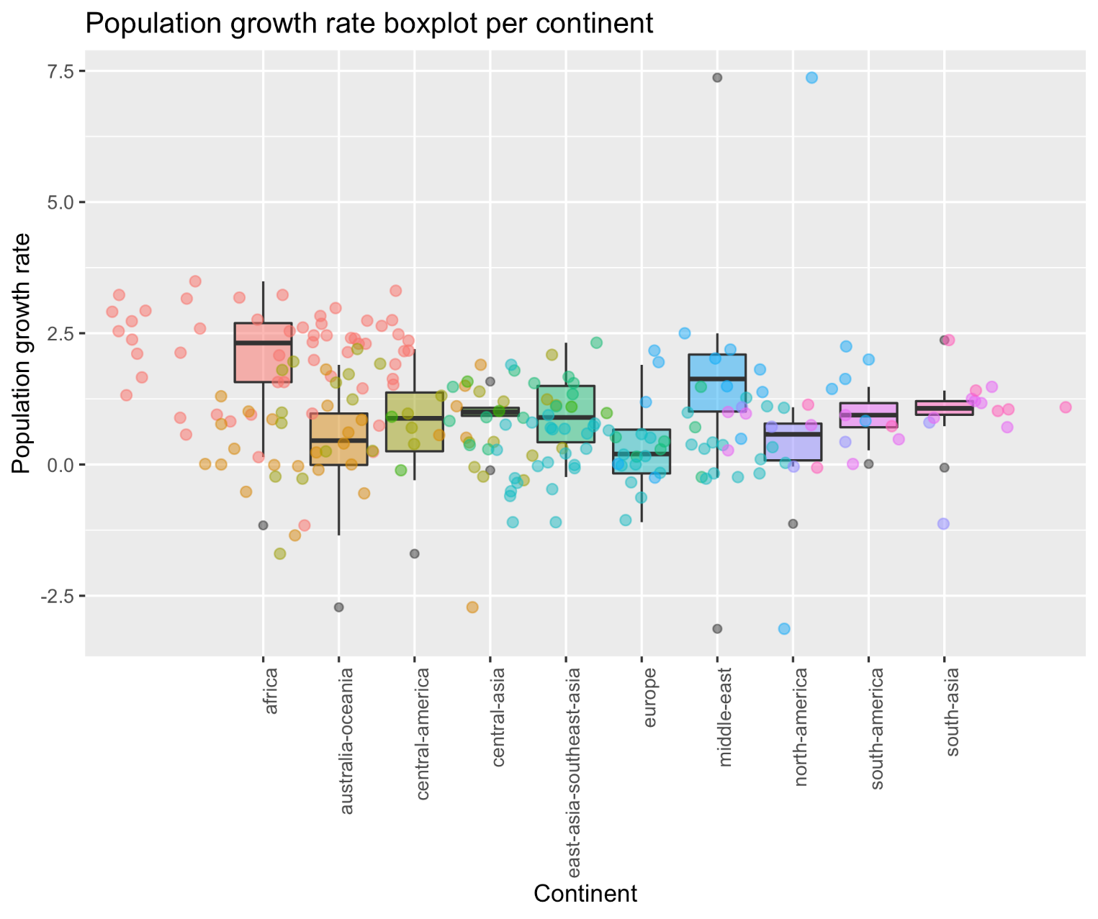
Population growth rate
Population growth rate compares the average annual percent change in populations, resulting from a surplus (or deficit) of births over deaths and the balance of migrants entering and leaving a country. The rate may be positive or negative.
02
Life & aging

Slide 18
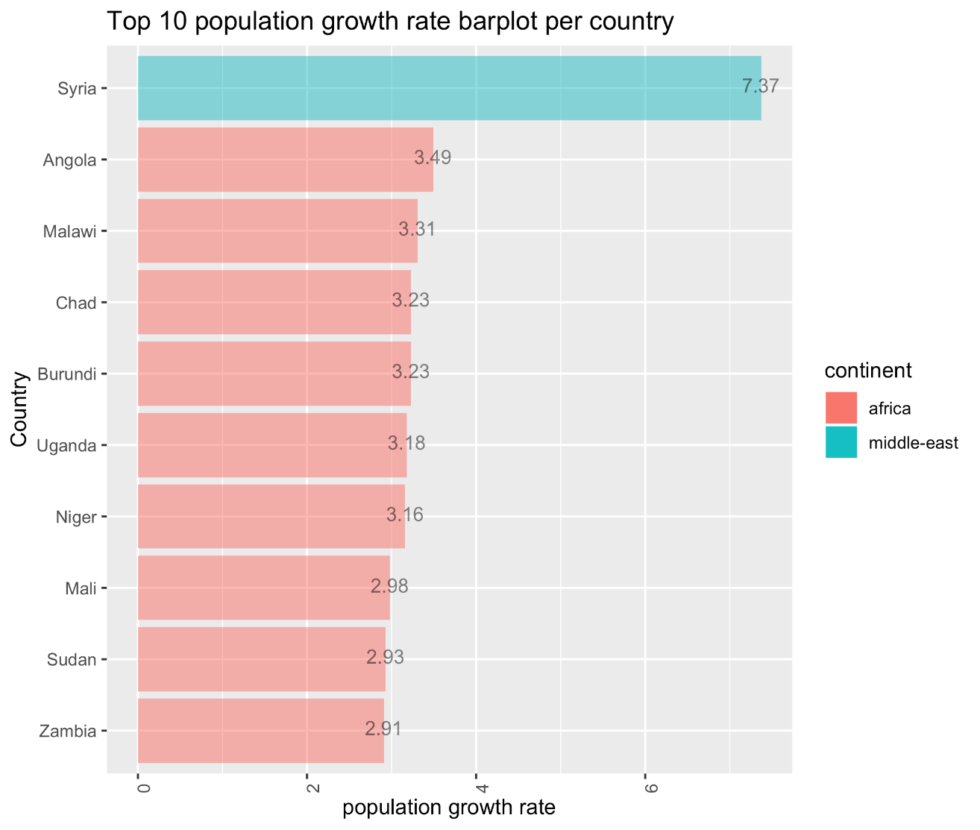
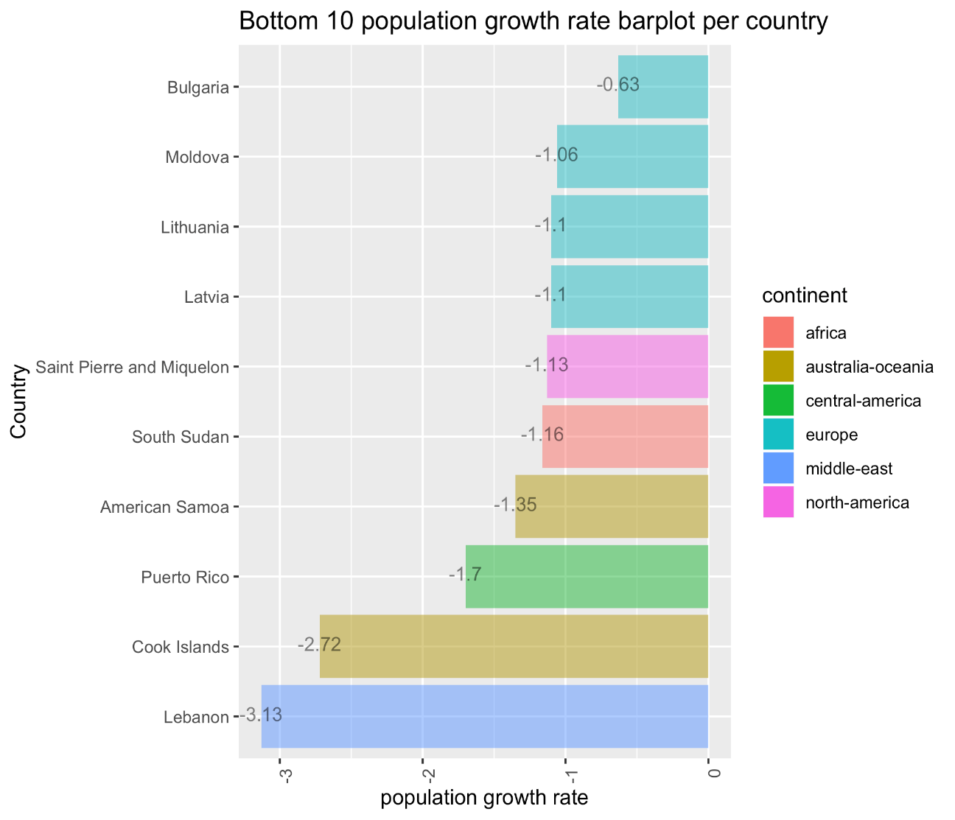
Population growth rate
Population growth rate compares the average annual percent change in populations, resulting from a surplus (or deficit) of births over deaths and the balance of migrants entering and leaving a country. The rate may be positive or negative.
02
Life & aging

Slide 19
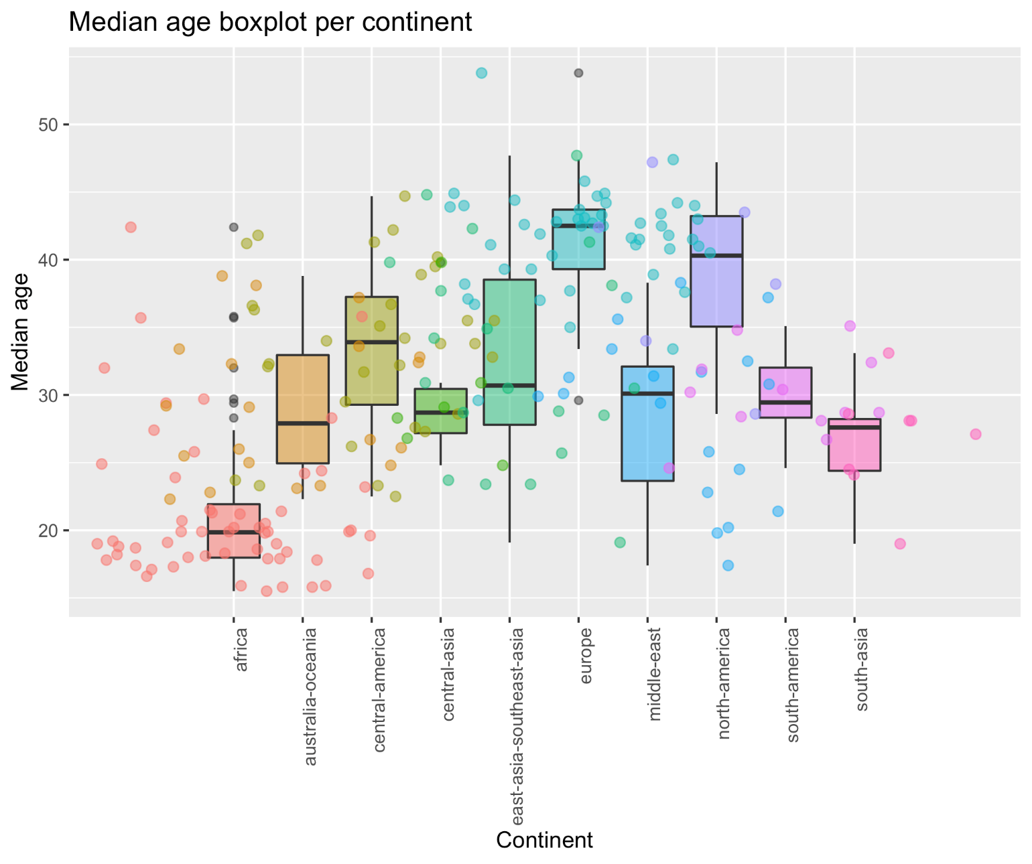
Median age
02
Life & aging

Slide 20
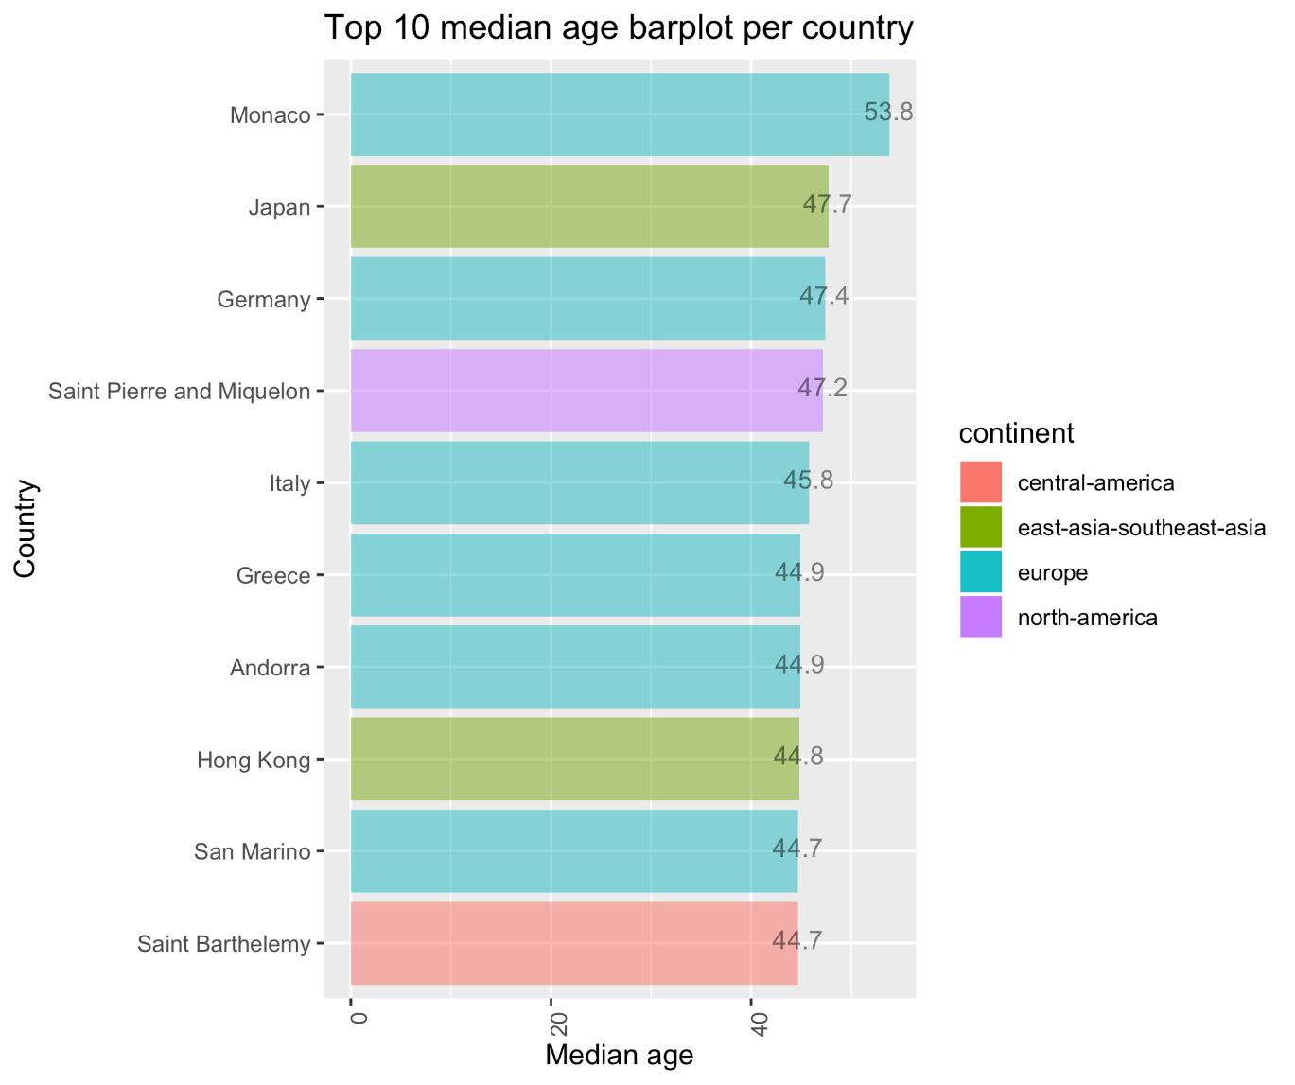
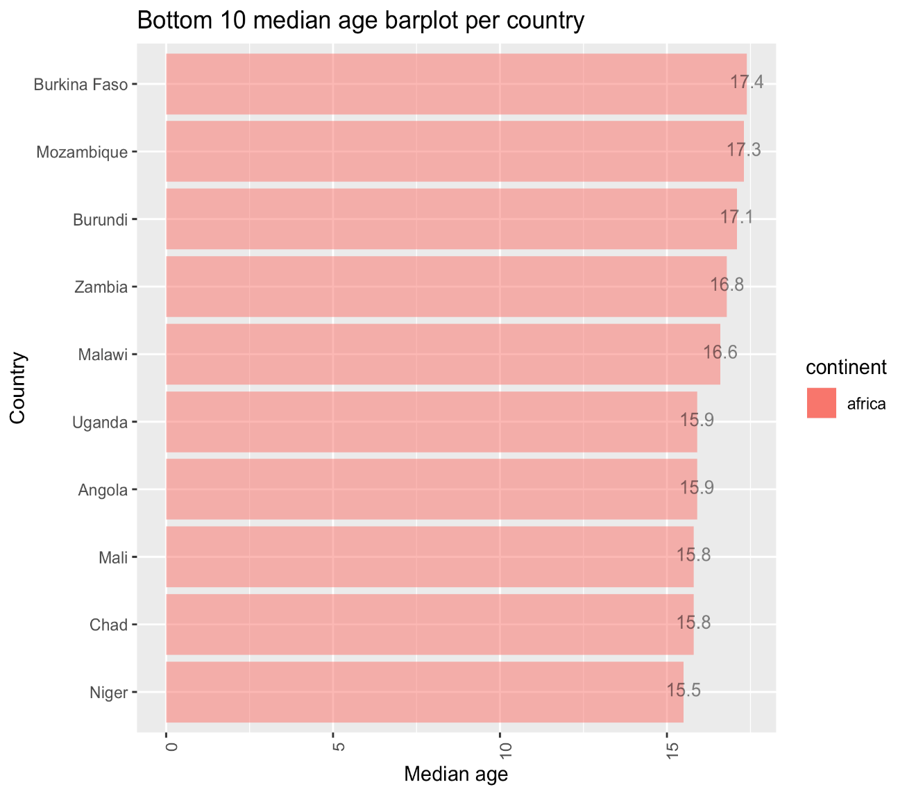
Median age
02
Life & aging

Slide 21
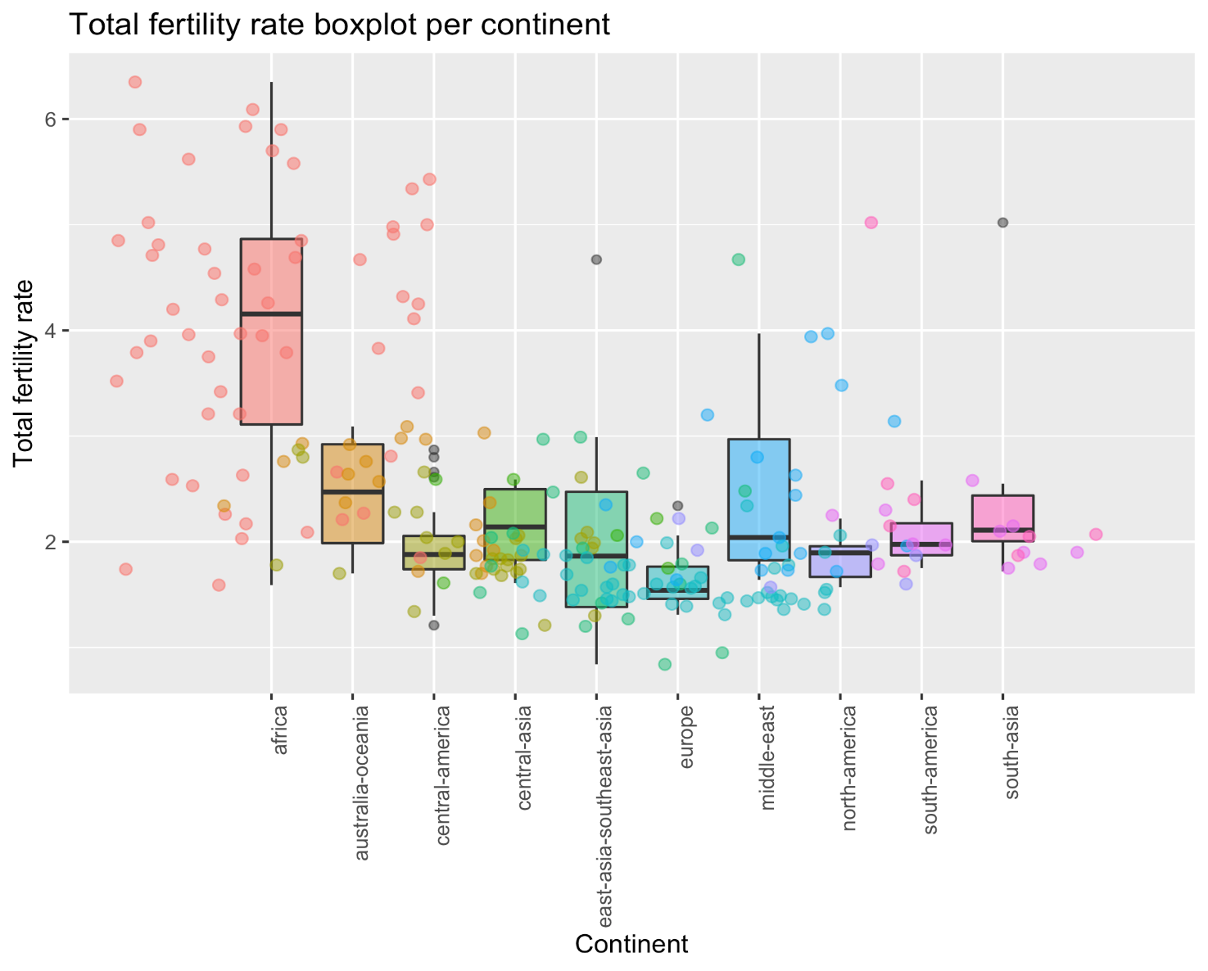
Total fertility rate
TFR compares figures for the average number of children that would be born per woman if all women lived to the end of their childbearing years and bore children according to a given fertility rate at each age. TFR is a more direct measure of the level of fertility than the crude birth rate, since it refers to births per woman.
02
Life & aging

Slide 22
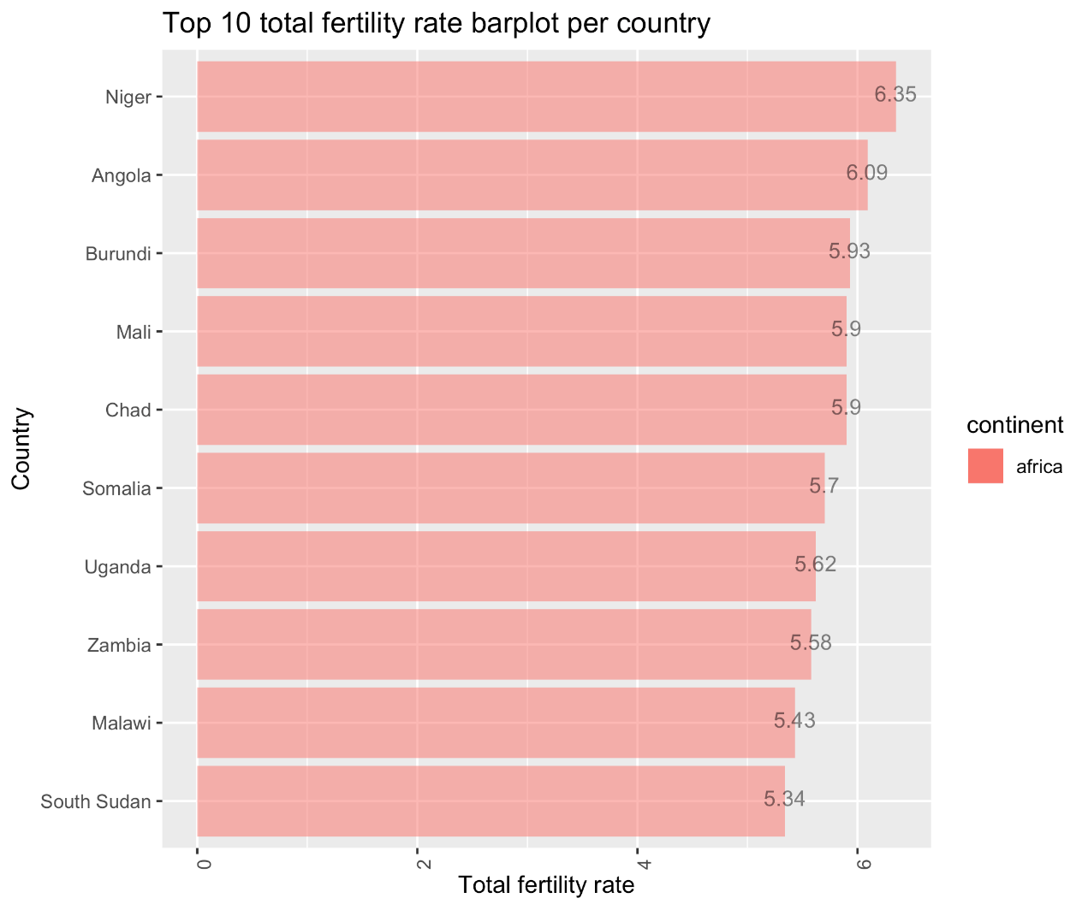
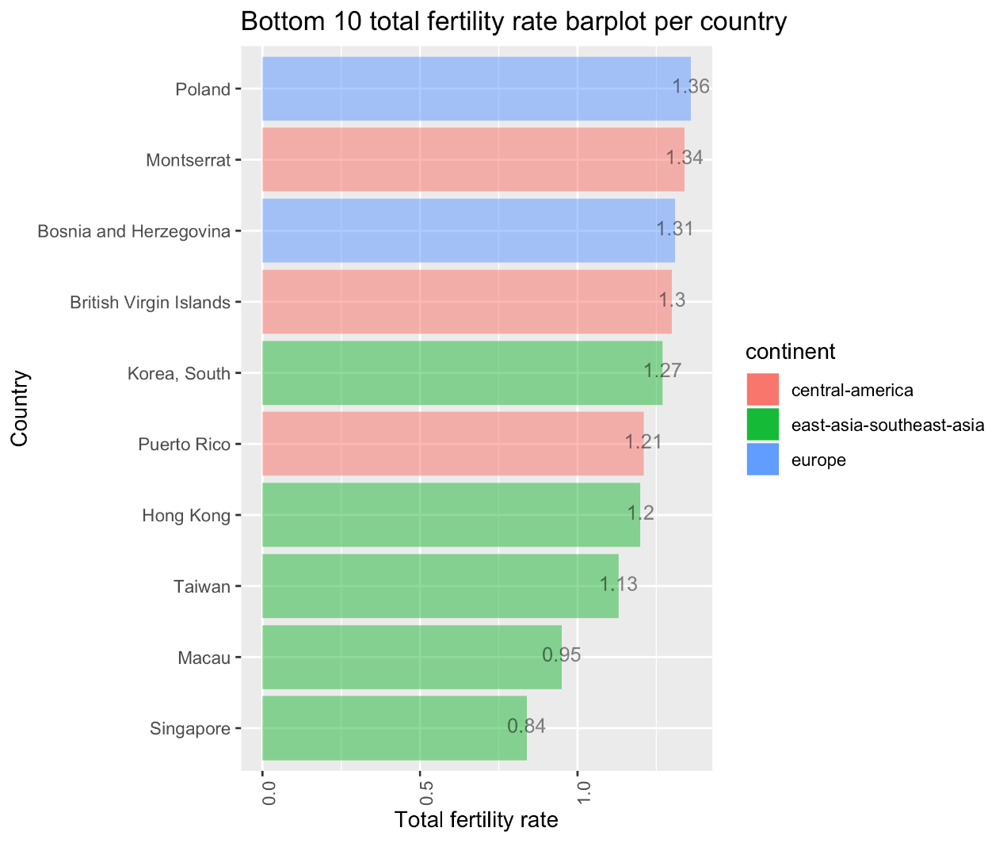
Total fertility rate
TFR compares figures for the average number of children that would be born per woman if all women lived to the end of their childbearing years and bore children according to a given fertility rate at each age. TFR is a more direct measure of the level of fertility than the crude birth rate, since it refers to births per woman.
02
Life & aging

Slide 23
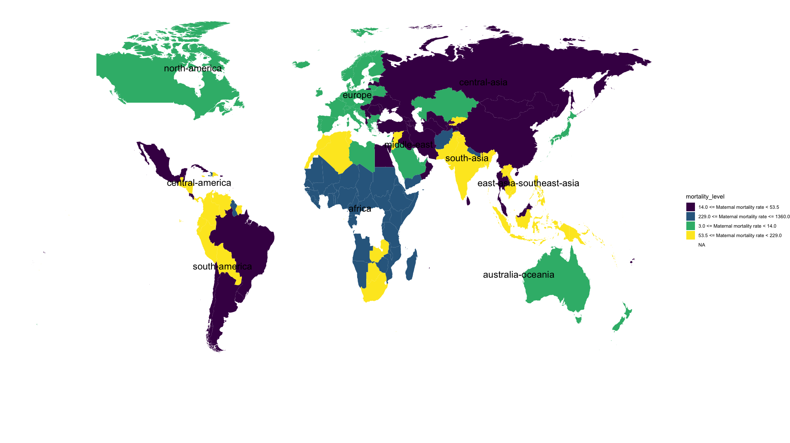
Mortality world heatmap
01
02
Mortality
Life & aging

Slide 24
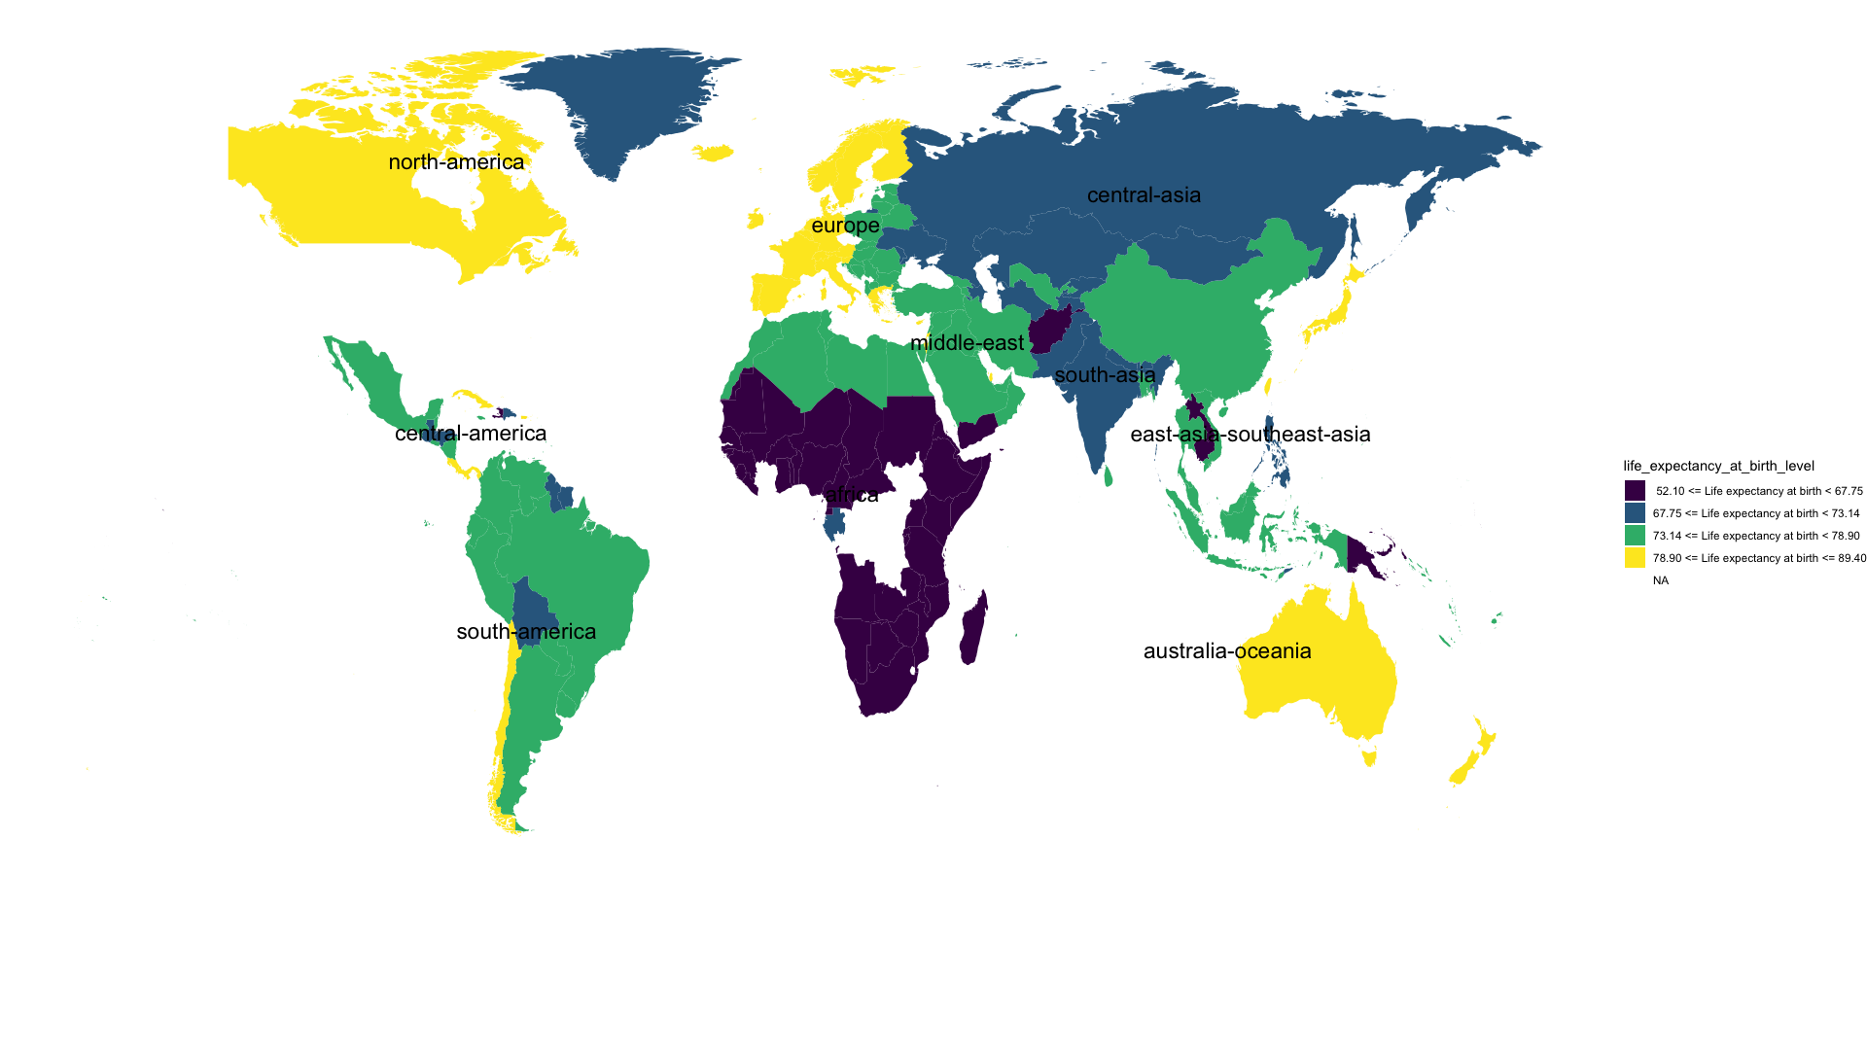
Life expectancy world heatmap
01
02
Mortality
Life & aging

Slide 25
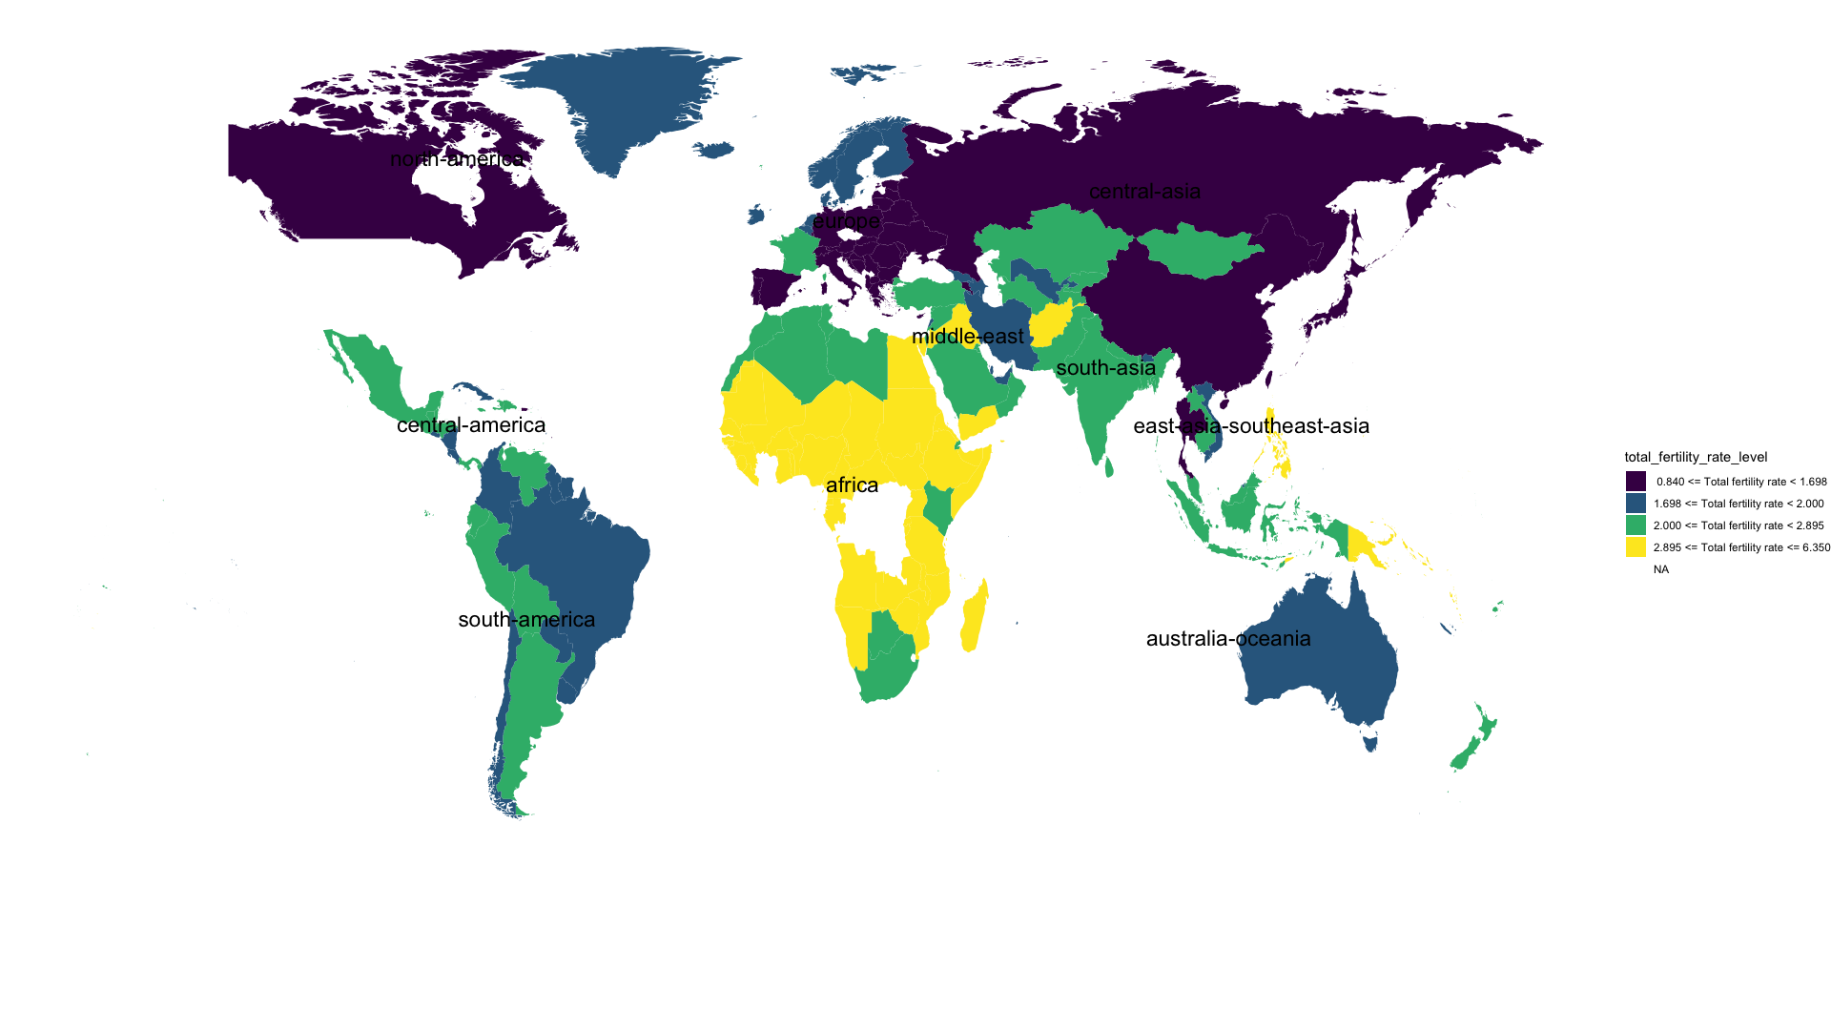
Total fertility rate world heatmap
01
02
Mortality
Life & aging

Slide 26
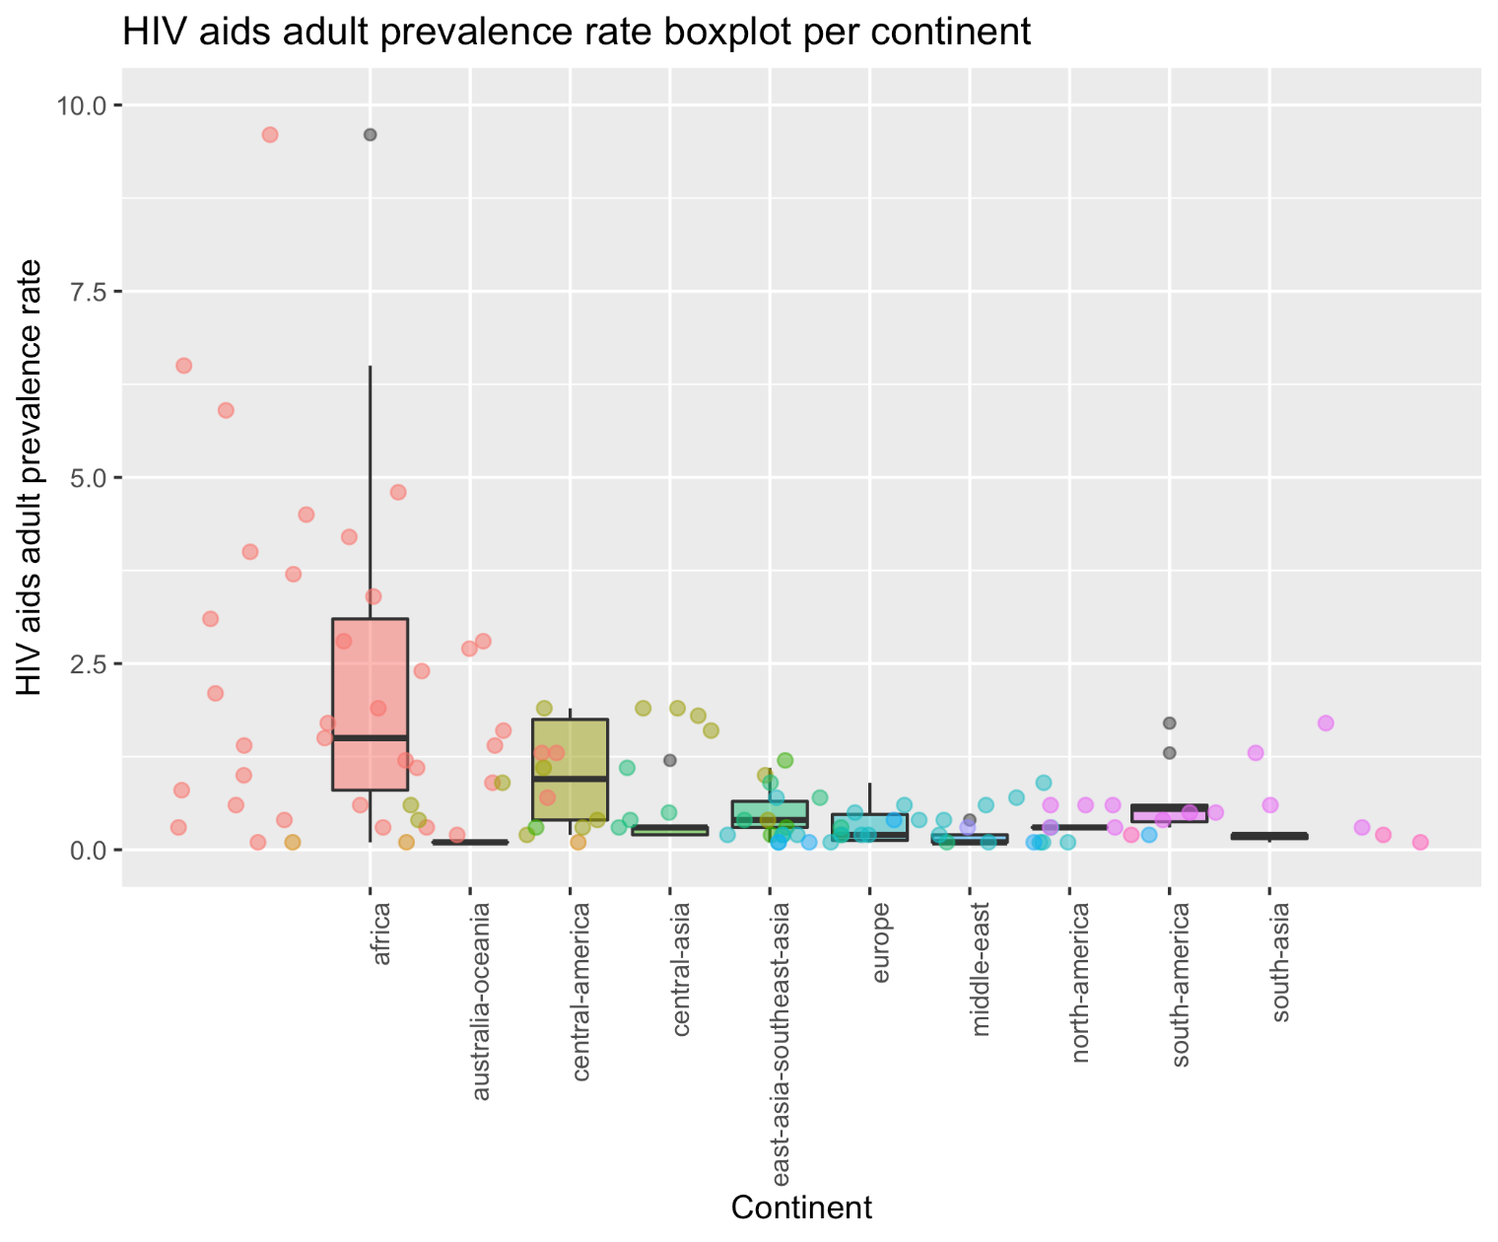
HIV/AIDS Adult prevalence rate
HIV/AIDS - adult prevalence rate compares the percentage of adults (aged 15-49) living with HIV/AIDS.
03
HIV/AIDS

Slide 27
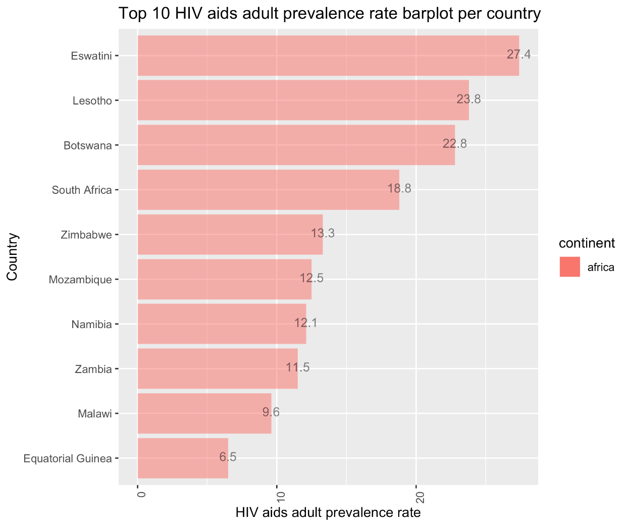
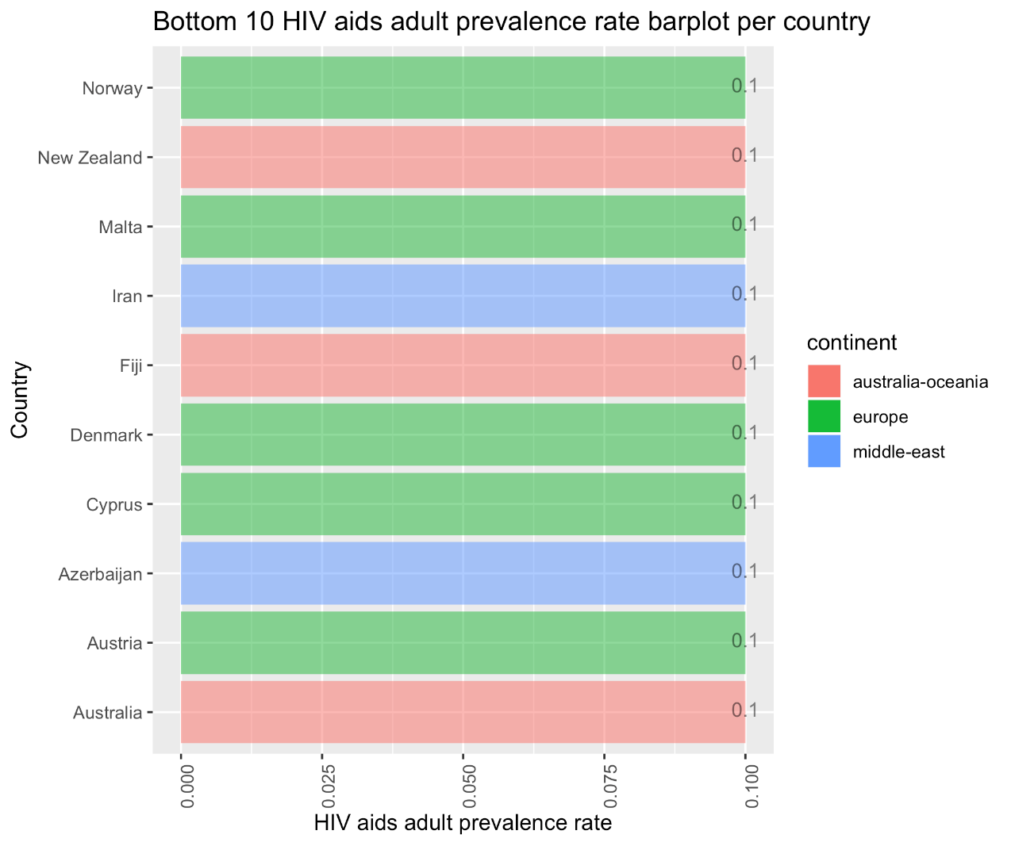
HIV/AIDS Adult prevalence rate
HIV/AIDS - adult prevalence rate compares the percentage of adults (aged 15-49) living with HIV/AIDS.
03
HIV/AIDS

Slide 28
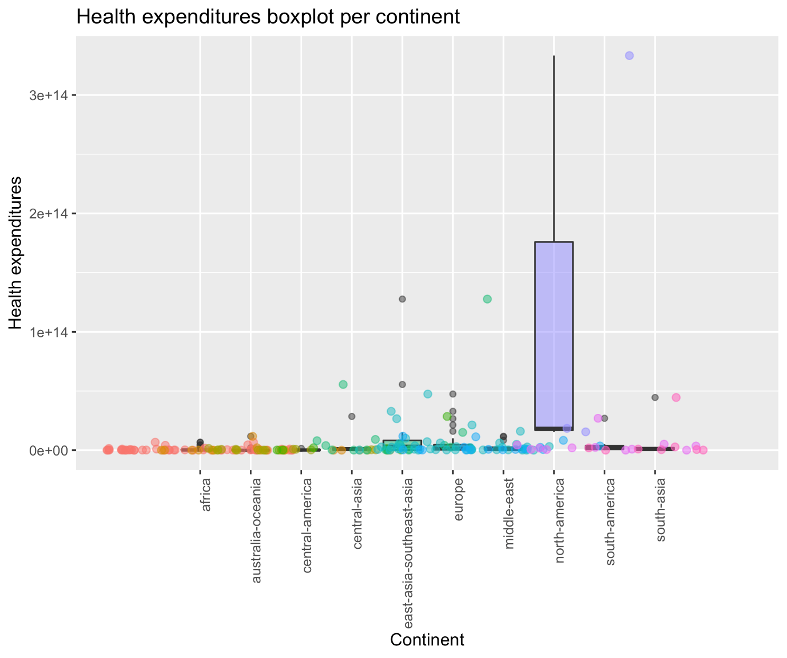
Health expenditure (by $)
Health expenditures provides the total expenditure on health. Health expenditures are broadly defined as activities performed either by institutions or individuals through the application of medical, paramedical, and/or nursing knowledge and technology, the primary purpose of which is to promote, restore, or maintain health.
04
Health expenditure

Slide 29
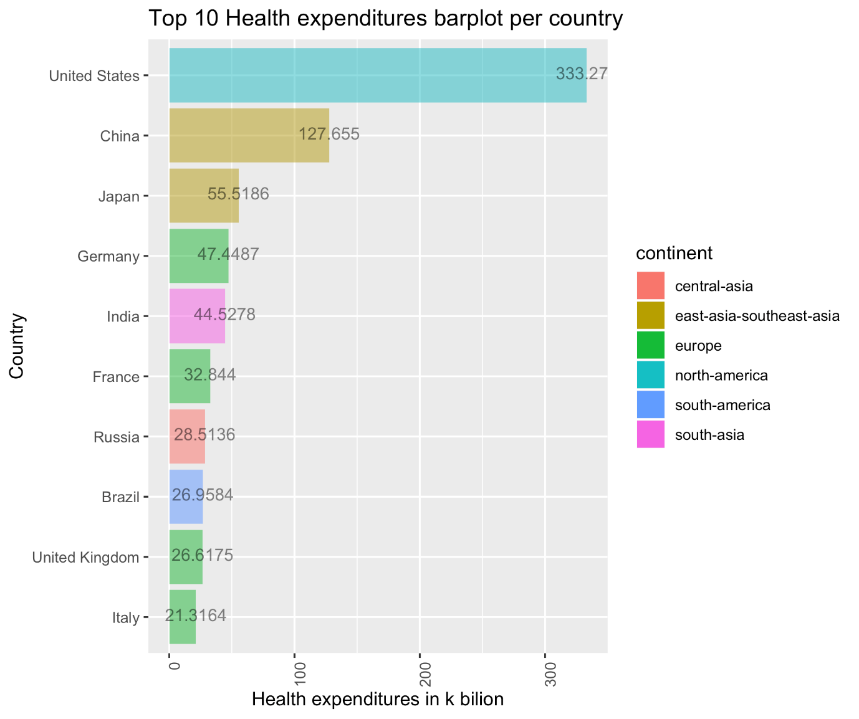
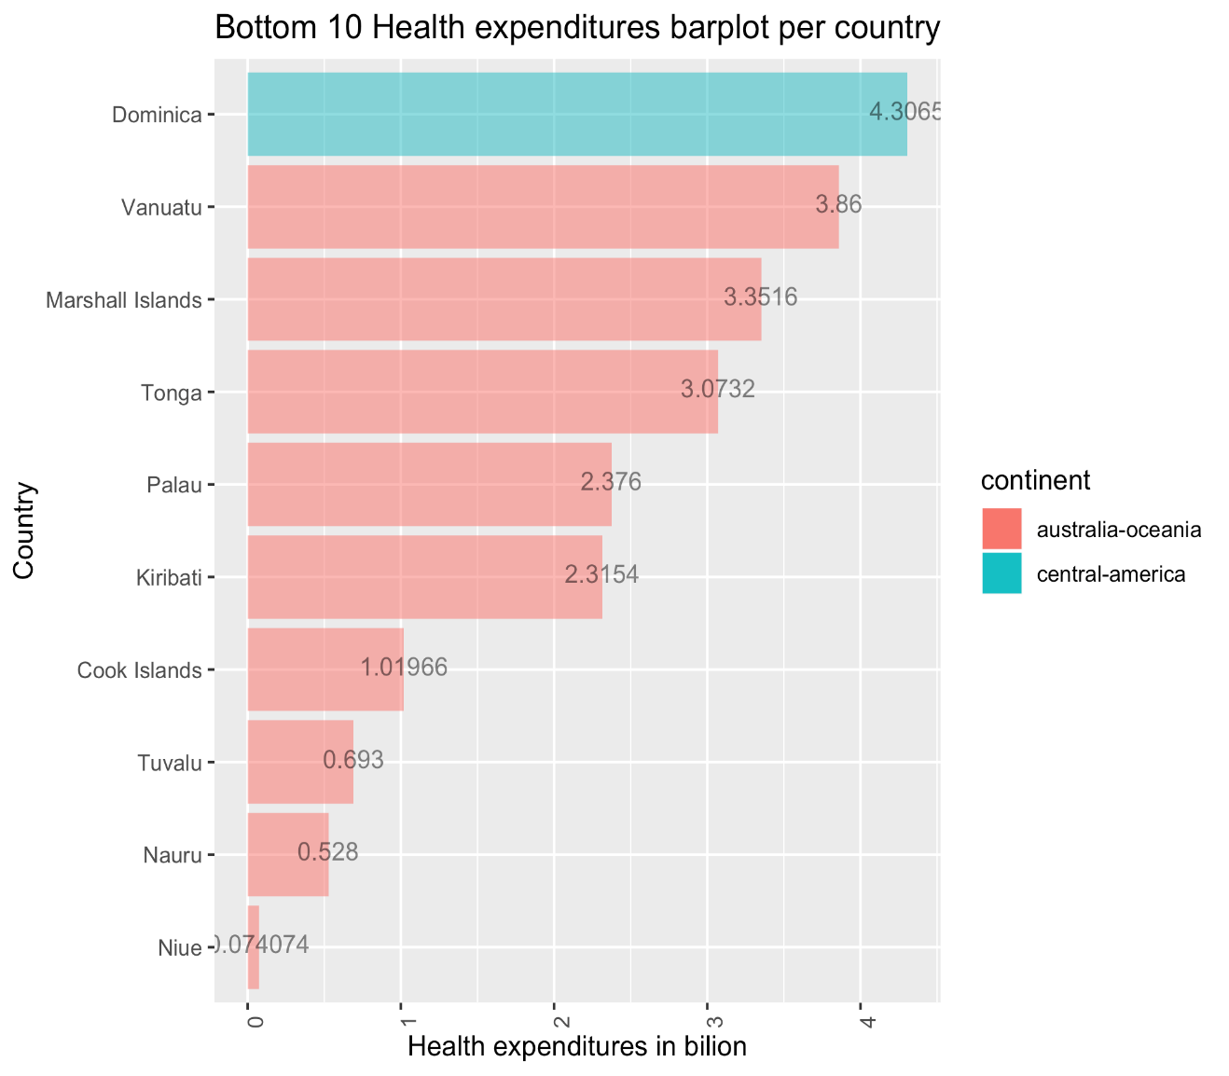
Health expenditure (by $)
Health expenditures provides the total expenditure on health. Health expenditures are broadly defined as activities performed either by institutions or individuals through the application of medical, paramedical, and/or nursing knowledge and technology, the primary purpose of which is to promote, restore, or maintain health.
04
Health expenditure

Slide 30
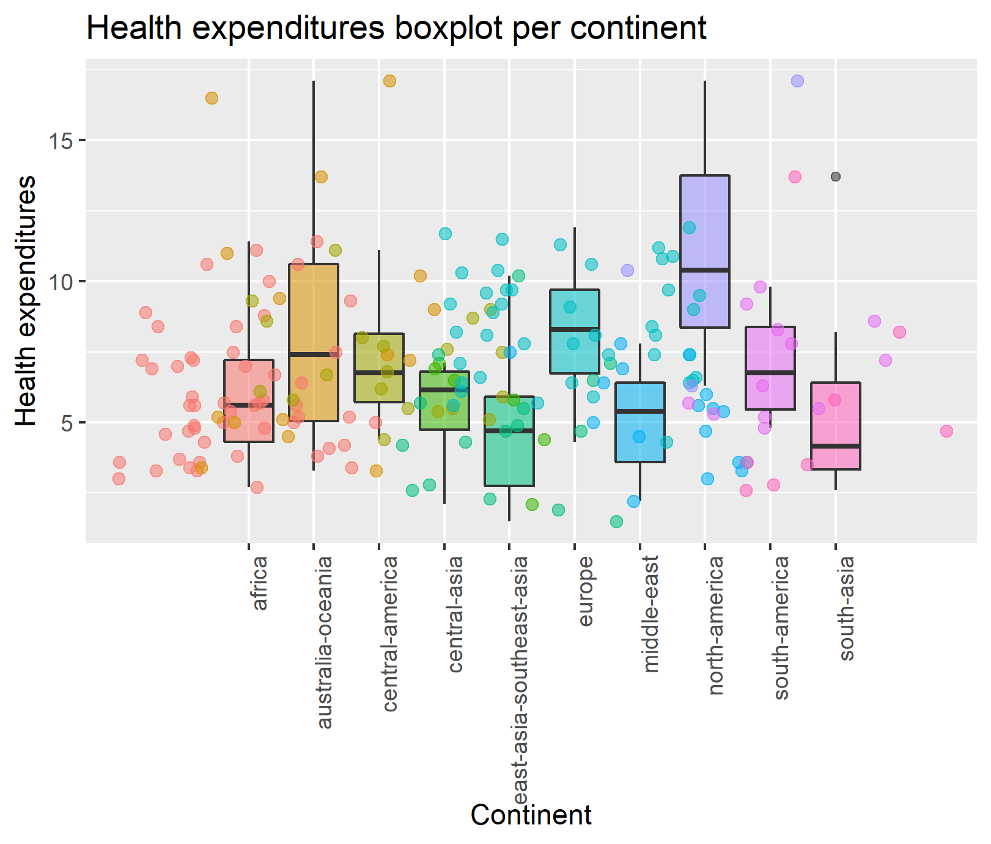
Health expenditure (by % of GDP)
Health expenditures provides the total expenditure on health. Health expenditures are broadly defined as activities performed either by institutions or individuals through the application of medical, paramedical, and/or nursing knowledge and technology, the primary purpose of which is to promote, restore, or maintain health.
04
Health expenditure

Slide 31
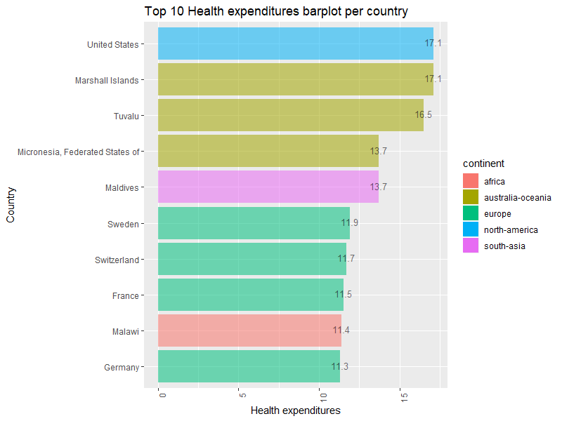
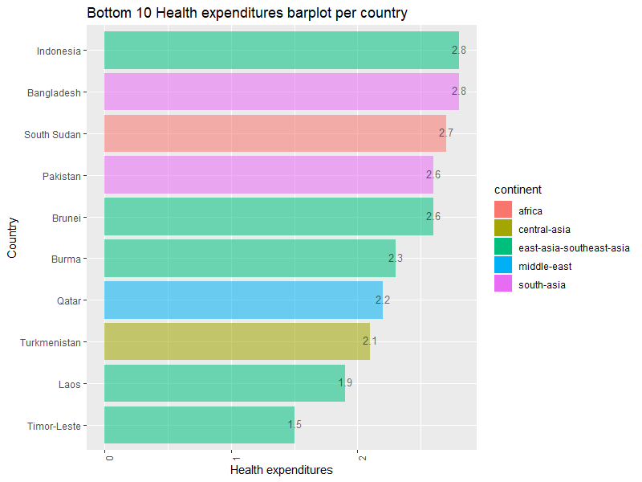
Health expenditure (by % of GDP)
Health expenditures provides the total expenditure on health. Health expenditures are broadly defined as activities performed either by institutions or individuals through the application of medical, paramedical, and/or nursing knowledge and technology, the primary purpose of which is to promote, restore, or maintain health.
04
Health expenditure

Slide 32
Are health expenditures really working?
THE QUESTION: Do higher health expenditures really lead to better results in terms of alleviating/solving these 8 prominent areas of global health concerns?
Maternal mortality
Infant mortality
Life expectancy at birth
Median age
Total fertility rate
HIV/AIDS adult prevalence rate
Obesity - adult prevalence rate
Children under the age of 5 years underweight
Next Step: Find the correlation between health expenditure ($) and measurements in those 8 areas of concern, for each continent.
05

Slide 33
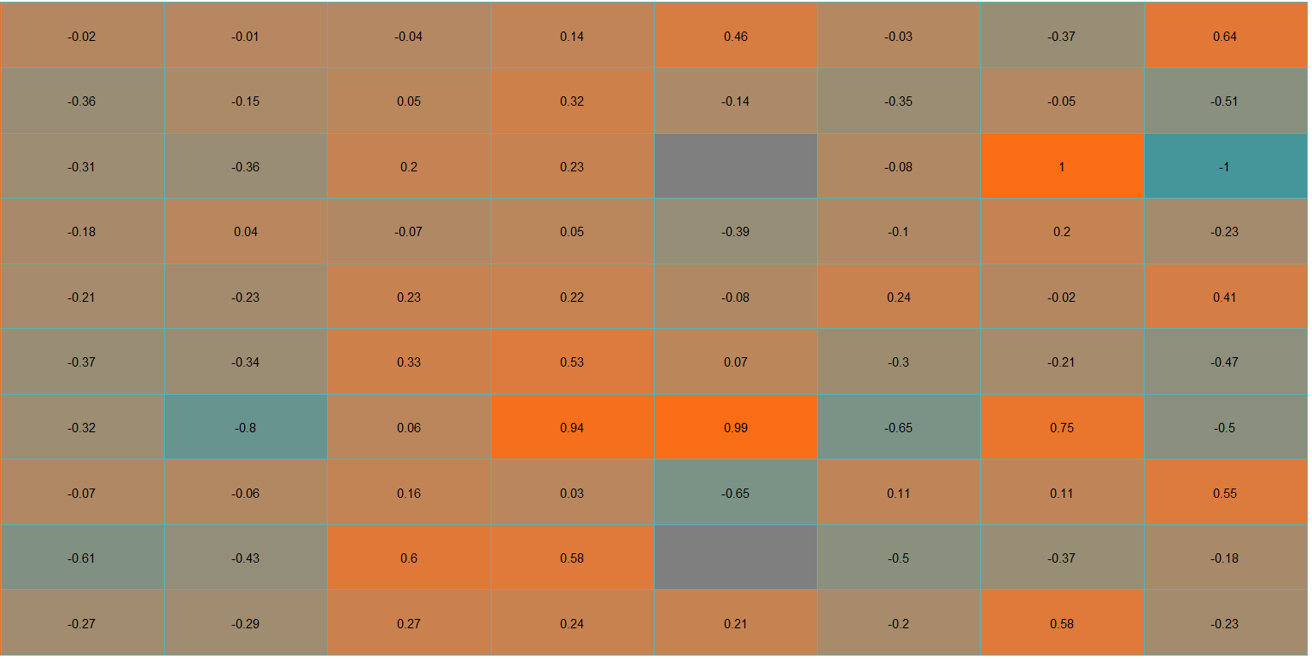
South Asia
South America
North America
Middle East
Europe
East & Southeast Asia
Central Asia
Central America
Australia-Oceania
Africa
Life expectancy
Median age
HIV/AIDs adult
prevalence rate
Obesity adult
prevalence rate
Children (<5 yrs)
underweight rate
Maternal mortality rate
Infant mortality rate
Total fertility rate

Slide 34
South Asia
South America
North America
Middle East
Europe
East & Southeast Asia
Central Asia
Central America
Australia-Oceania
Africa
Life expectancy
Median age
HIV/AIDs adult
prevalence rate
Obesity adult
prevalence rate
Children (<5 yrs)
underweight rate
Maternal mortality rate
Infant mortality rate
Total fertility rate

Slide 35
South Asia
South America
North America
Middle East
Europe
East & Southeast Asia
Central Asia
Central America
Australia-Oceania
Africa
Life expectancy
Median age
HIV/AIDs adult
prevalence rate
Obesity adult
prevalence rate
Children (<5 yrs)
underweight rate
Maternal mortality rate
Infant mortality rate
Total fertility rate

Slide 36
AGENDA
01
Introduction
02
Web Scraping
03
Topic 1: People and Health
04
Topic 2: Education, Communication and Economy
05
Conclusion and Wrap Up
Notes:
© Copyright Showeet.com

Slide 37
Education, Communication and Economy
06
07
08
Size of economy
Okun’s Law
– Does it apply to all countries?
Internet usage
GDP
GDP real growth rate
GDP per capita vs. internet users
Unemployment rate vs. GDP per capita
09
10
Health expenditure problem revisited
Education expenditure
What if we group countries into 3 GDP brackets:
Low GDP countries
Middle GDP countries
High GDP countries
Would correlation matrix look different?
Education expenditure by $
Education expenditure by % of GDP
GDP per capita vs. education expenditure

Slide 38
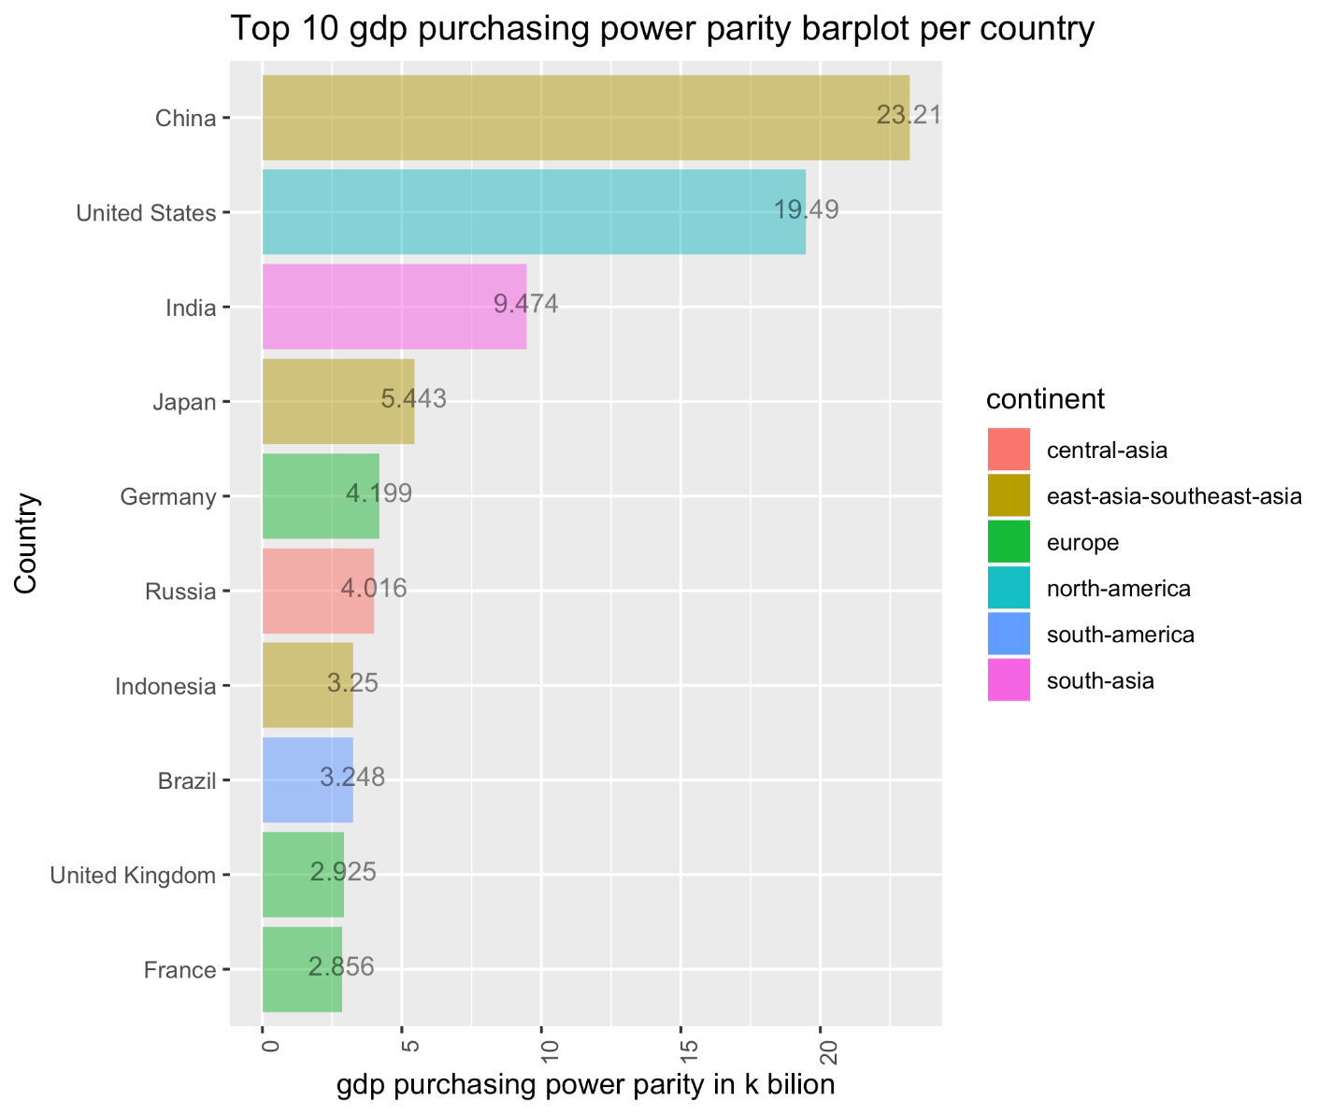
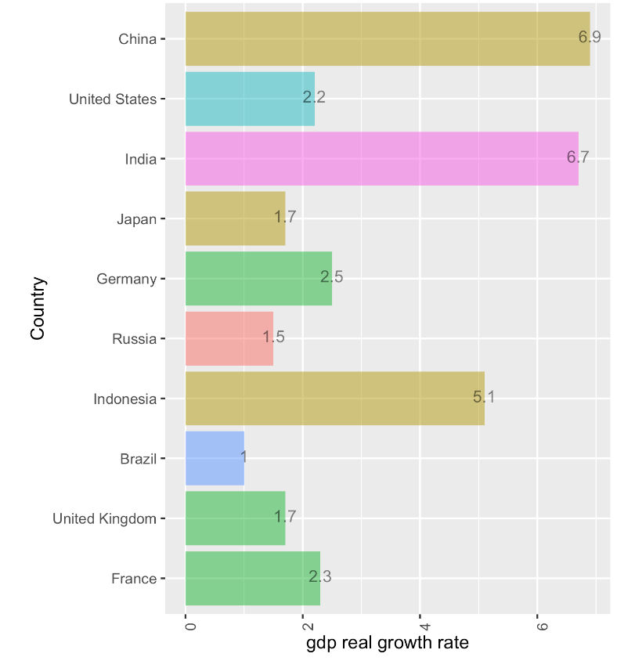
GDP
GDP (purchasing power parity) compares the gross domestic product (GDP) or value of all final goods and services produced within a nation in a given year. A nation's GDP at purchasing power parity (PPP) exchange rates is the sum value of all goods and services produced in the country valued at prices prevailing in the United States.
02
06
Size of economy

Slide 39
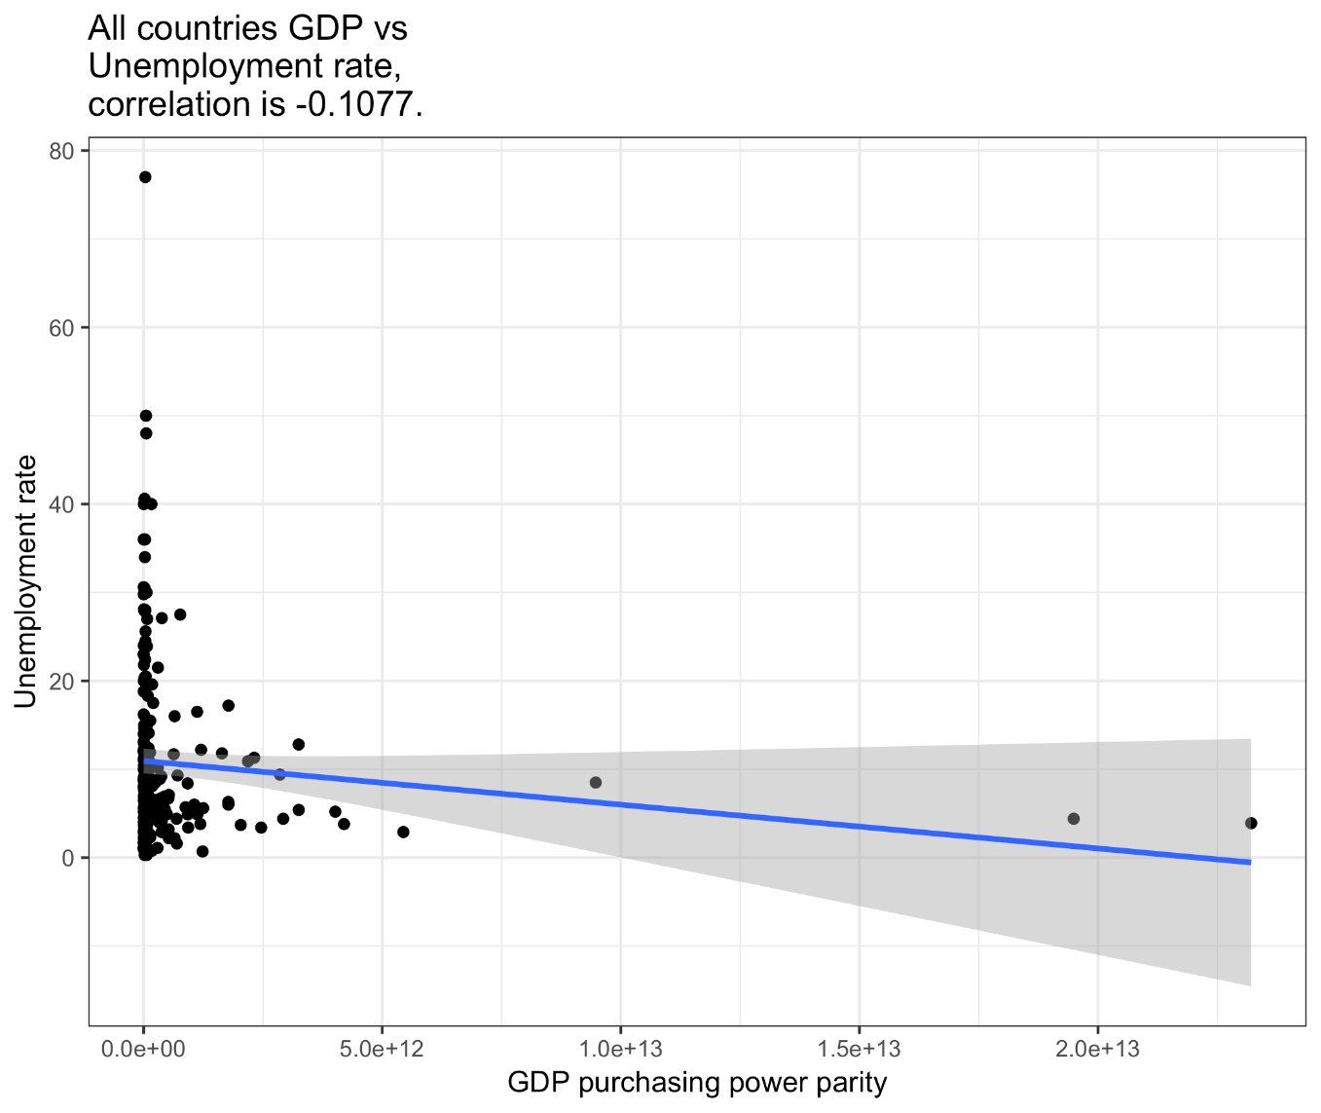
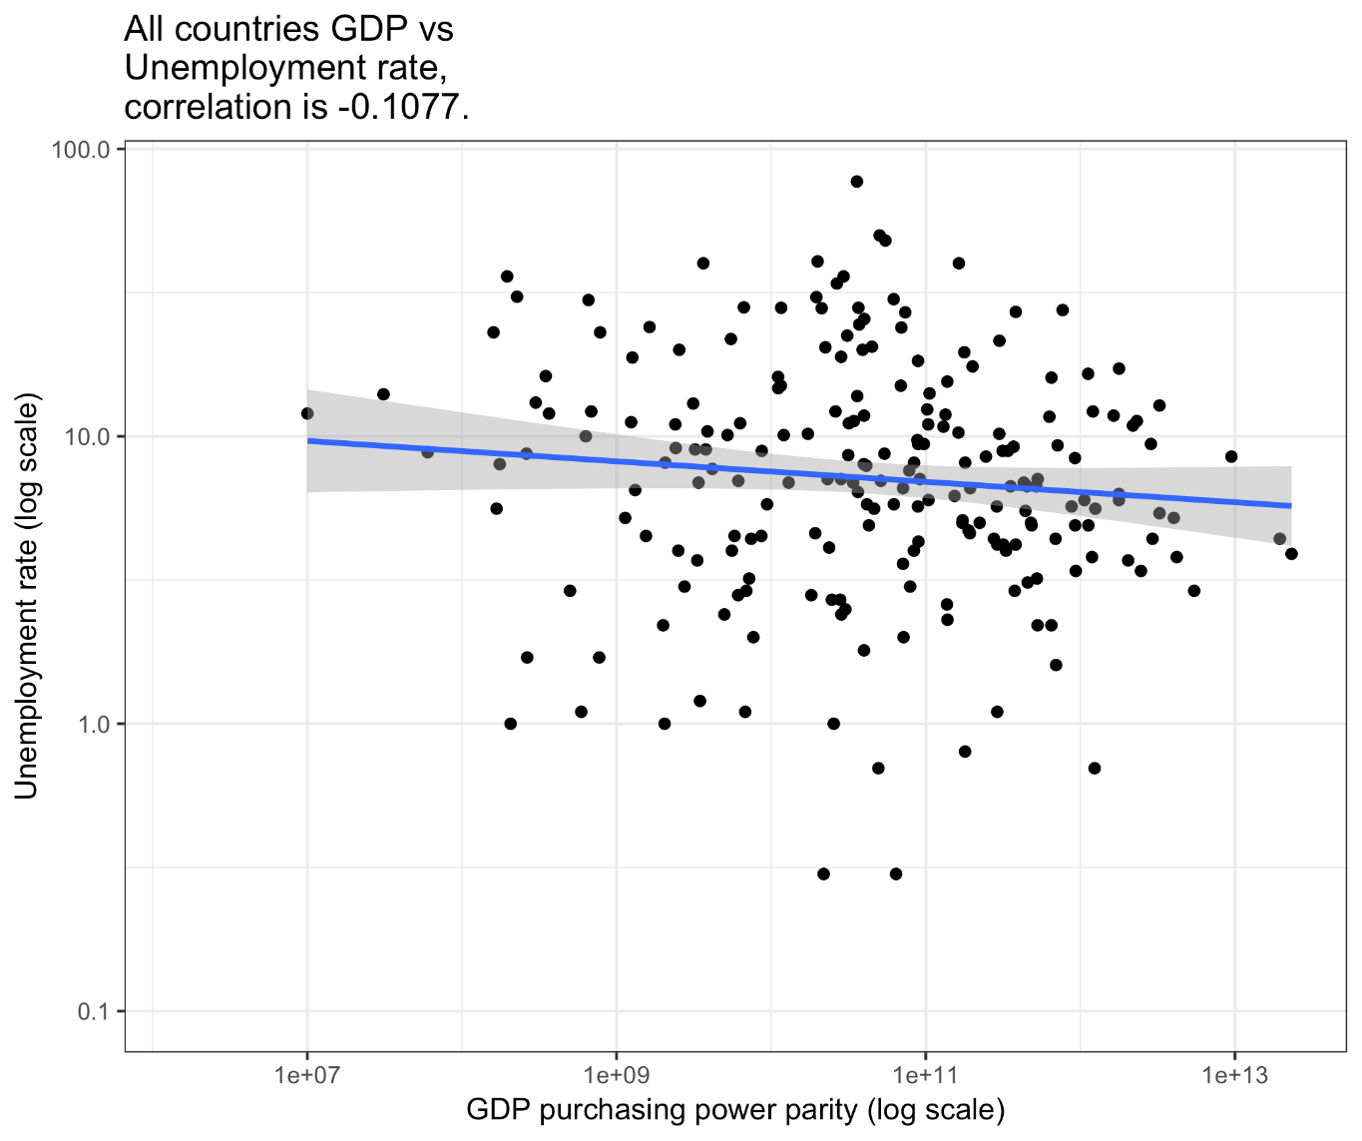
Okun’s Law
In economics, Okun‘s law is an empirically observed relationship between unemployment and losses in a country’s production. The “gap version” states that for every 1% increase in the unemployment rate, a country‘s GDP will be roughly an additional 2% lower than its potential GDP. (i.e. unemployment : GDP ≈ - 0.5:1)
07
Okun’s Law

Slide 40
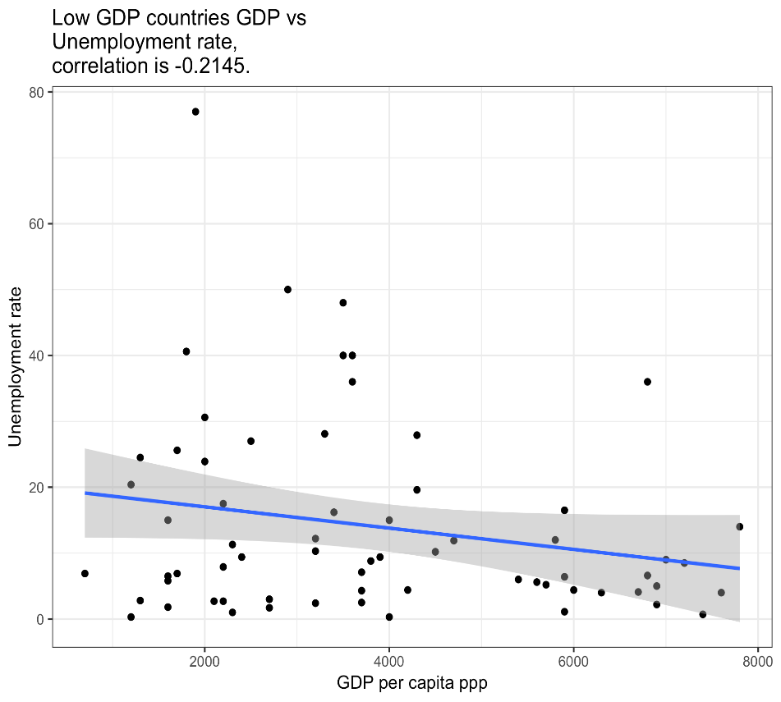
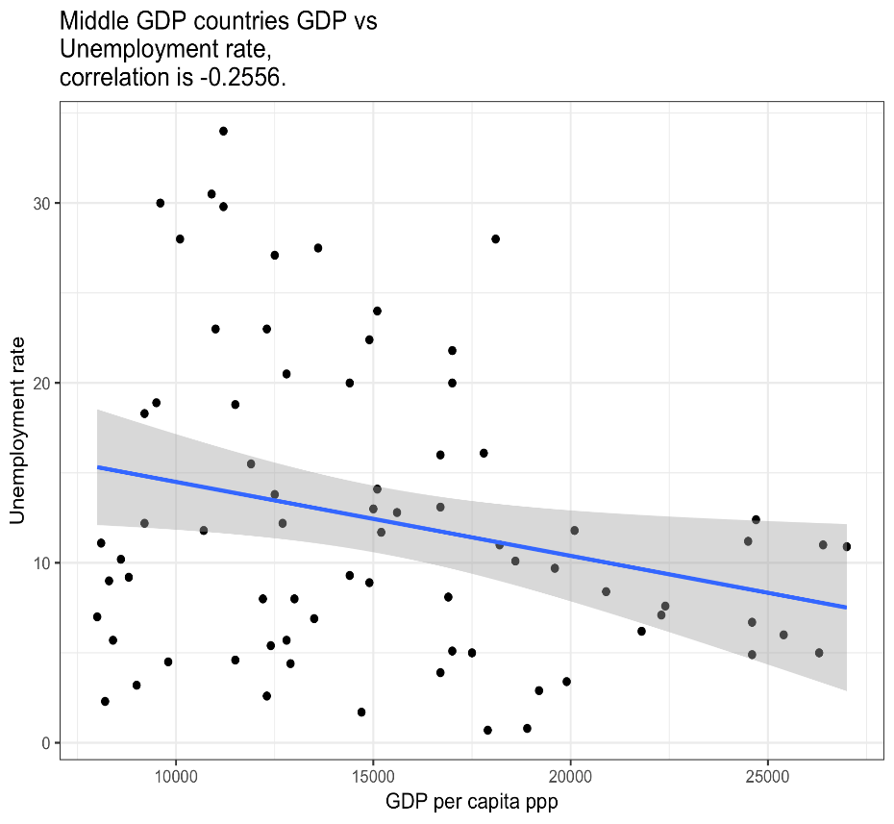
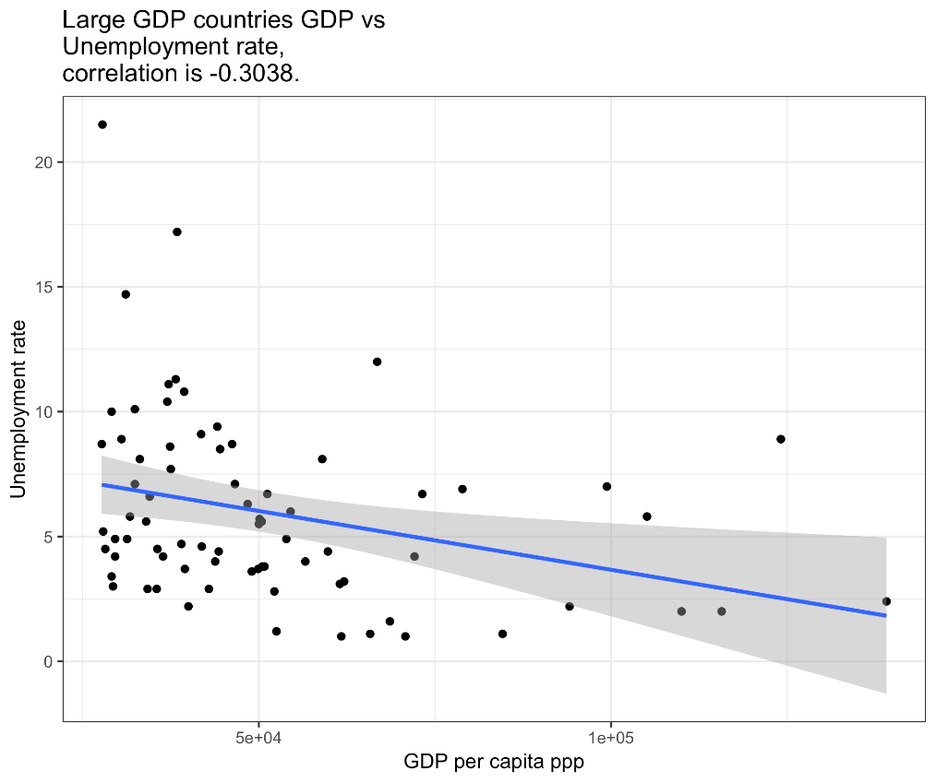
Okun’s Law
In economics, Okun's law is an empirically observed relationship between unemployment and losses in a country's production. The "gap version" states that for every 1% increase in the unemployment rate, a country's GDP will be roughly an additional 2% lower than its potential GDP. (i.e. unemployment : GDP ≈ - 0.5:1)
Group countries into 3 GDP brackets:
Low GDP countries
Middle GDP countries
High GDP countries
07
Okun’s Law

Slide 41
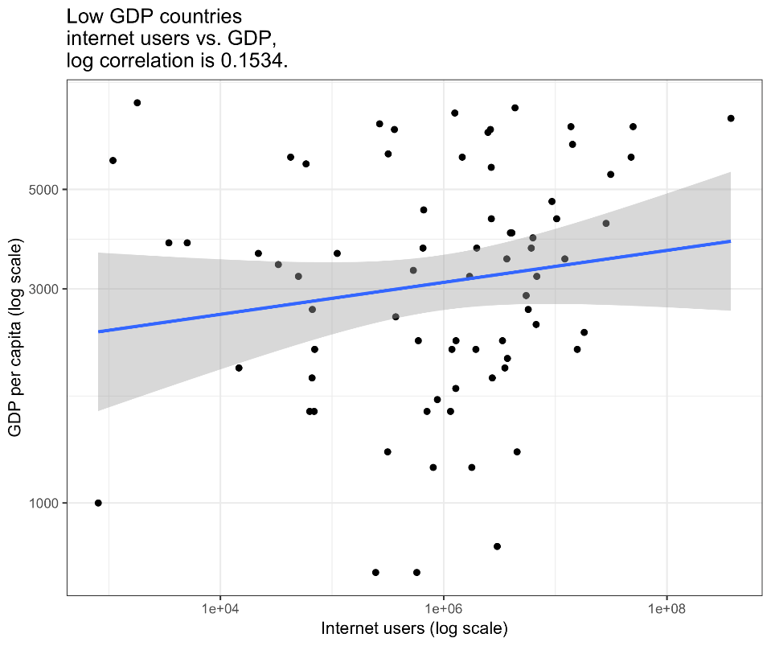
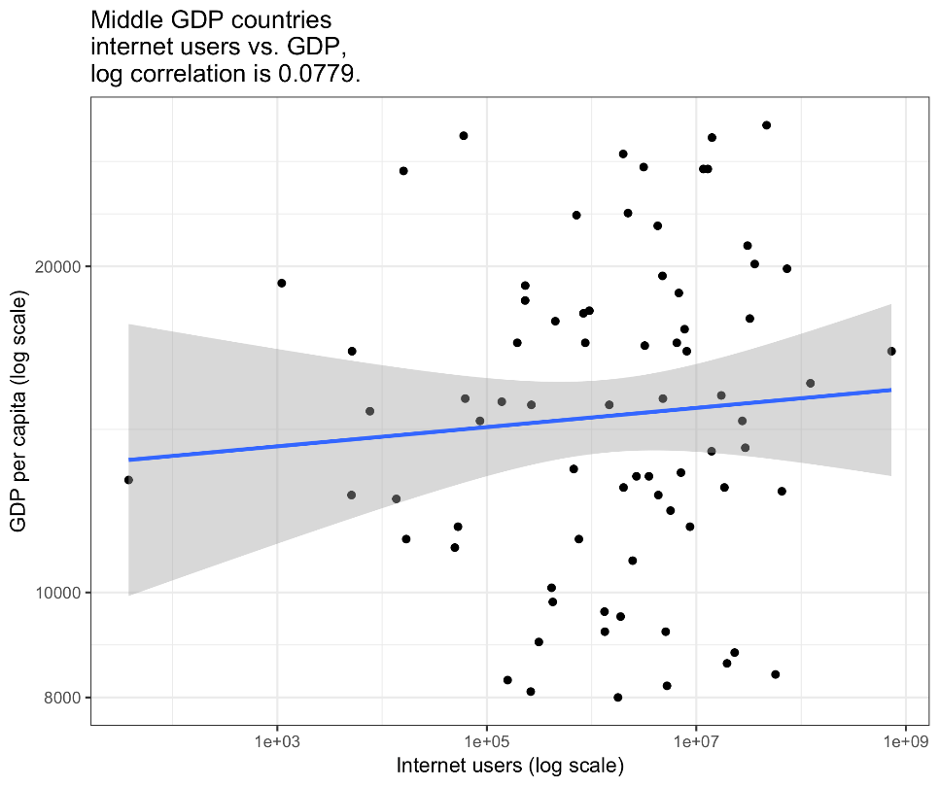
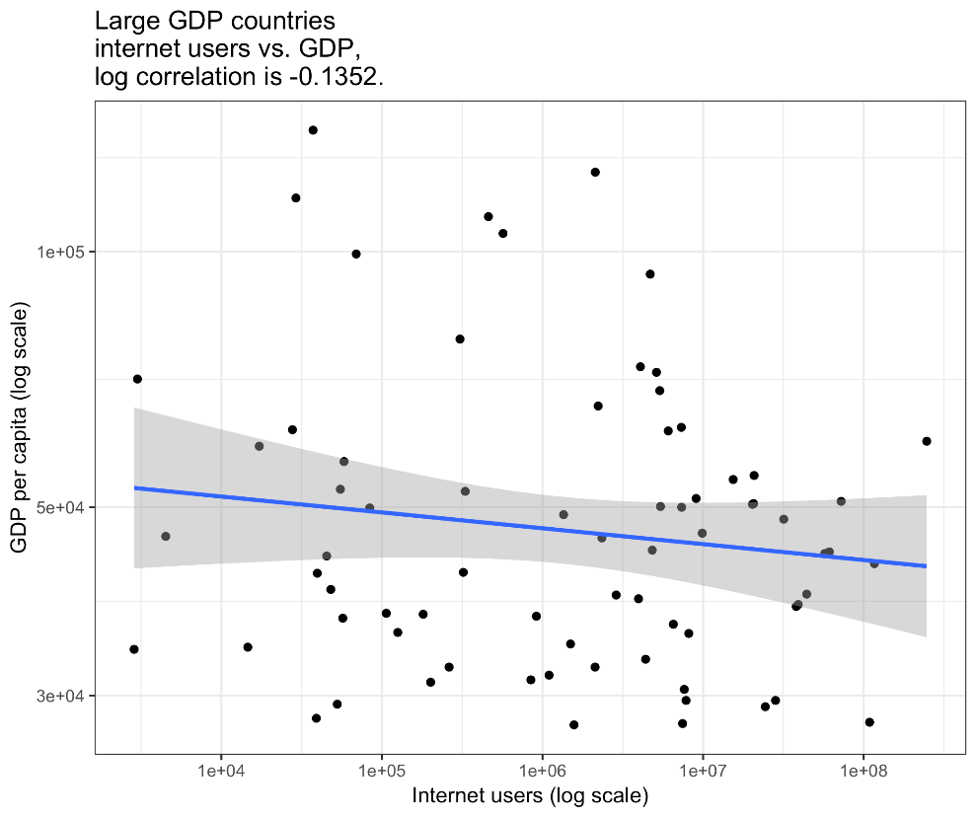
GDP per capita vs. internet users
Internet users compares the number of users within a country that access the Internet. Statistics vary from country to country and may include users who access the Internet at least several times a week to those who access it only once within a period of several months.
Group countries into 3 GDP brackets:
Low GDP countries
Middle GDP countries
High GDP countries
08
Internet usage

Slide 42
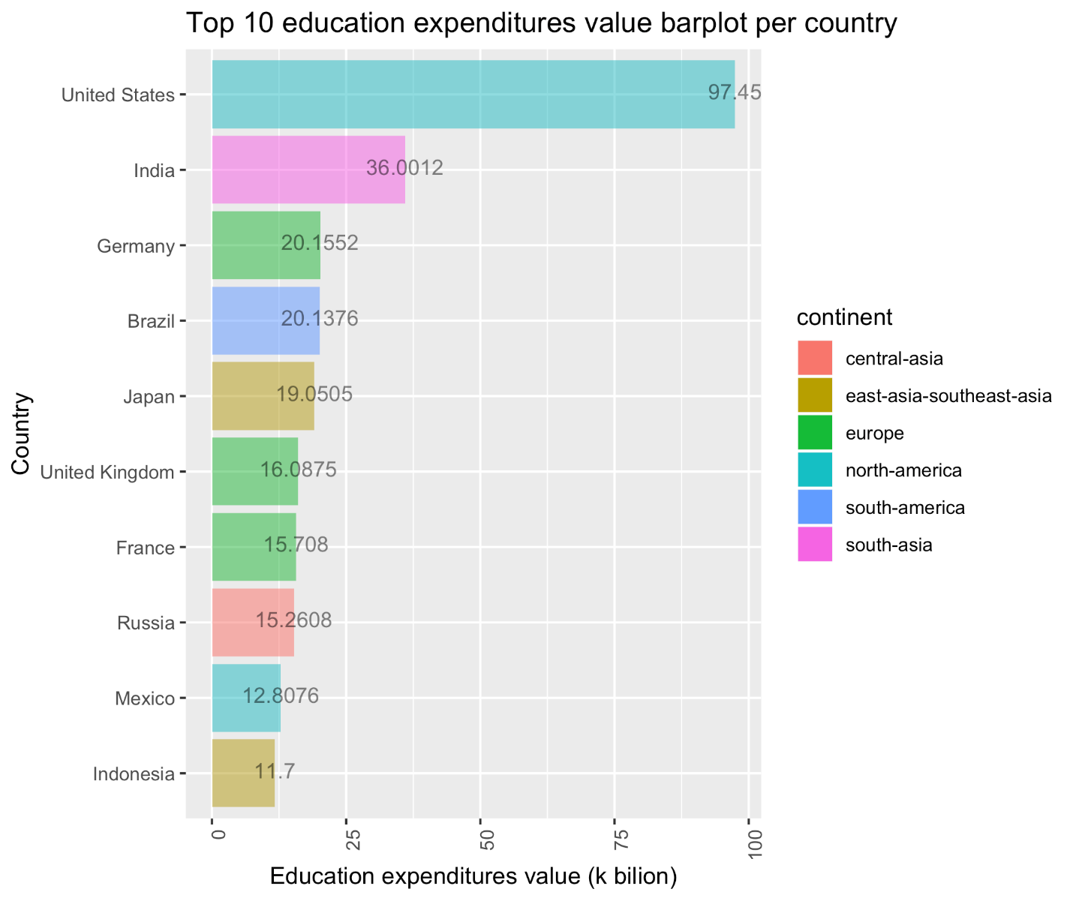
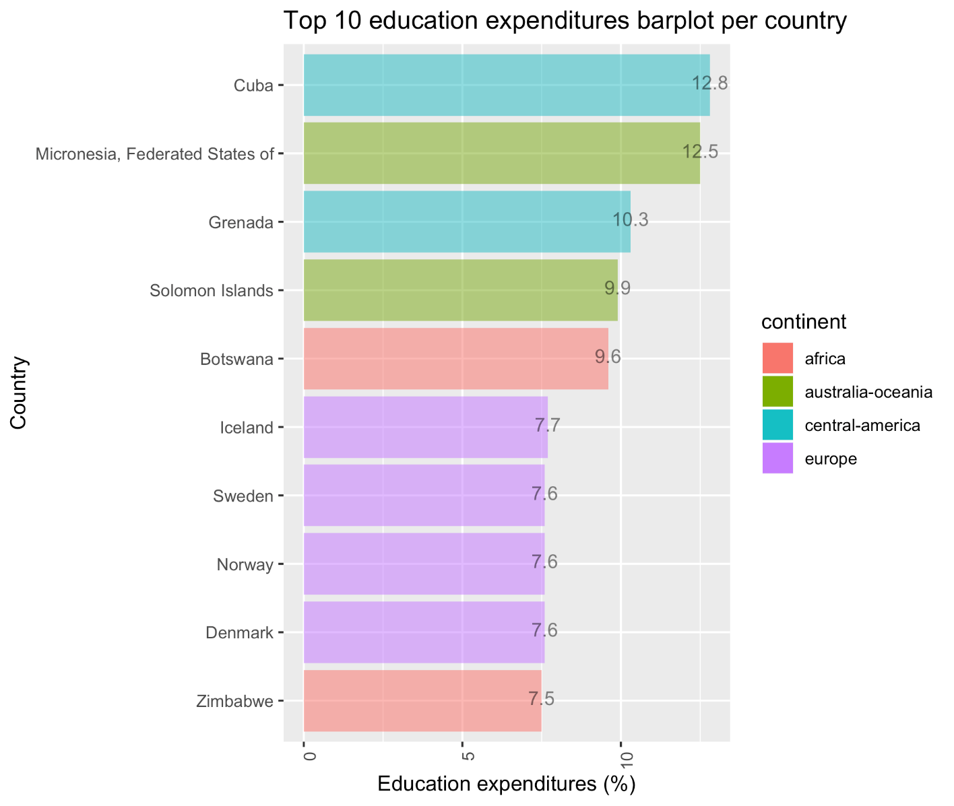
Education expenditure ($)
Education expenditure (% of GDP)
Education expenditures compares the public expenditure on education
09
Education expenditure

Slide 43
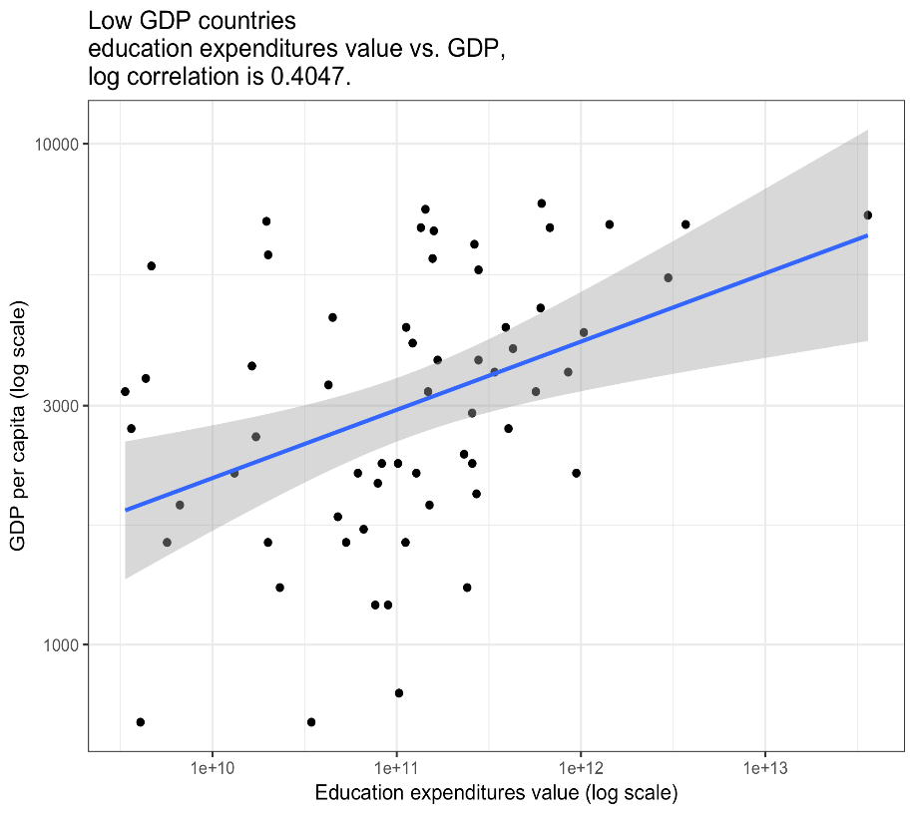
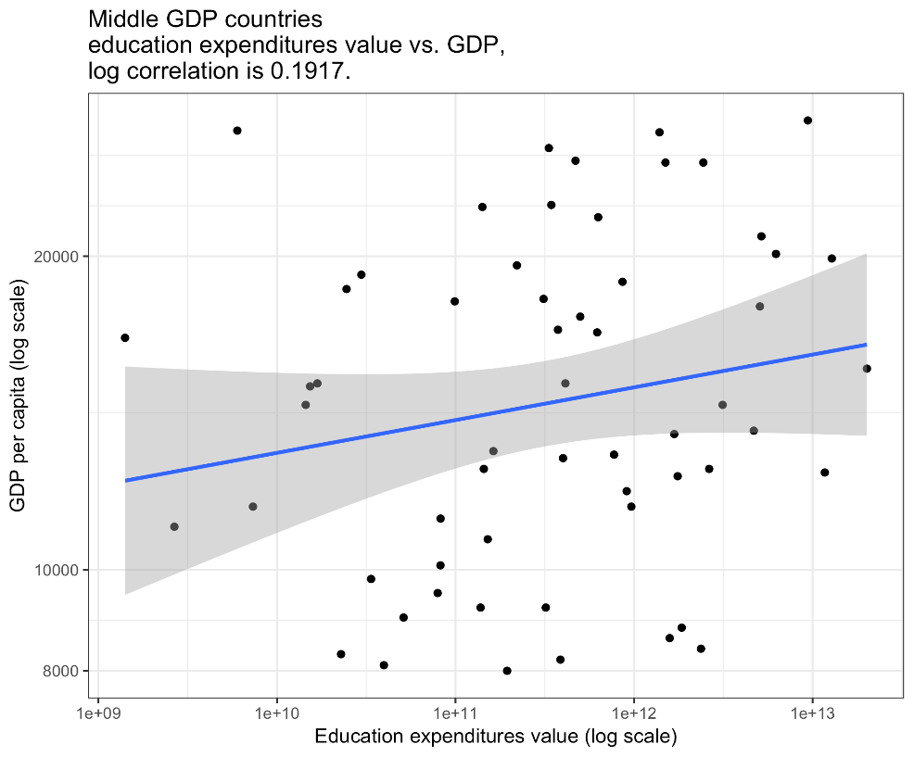
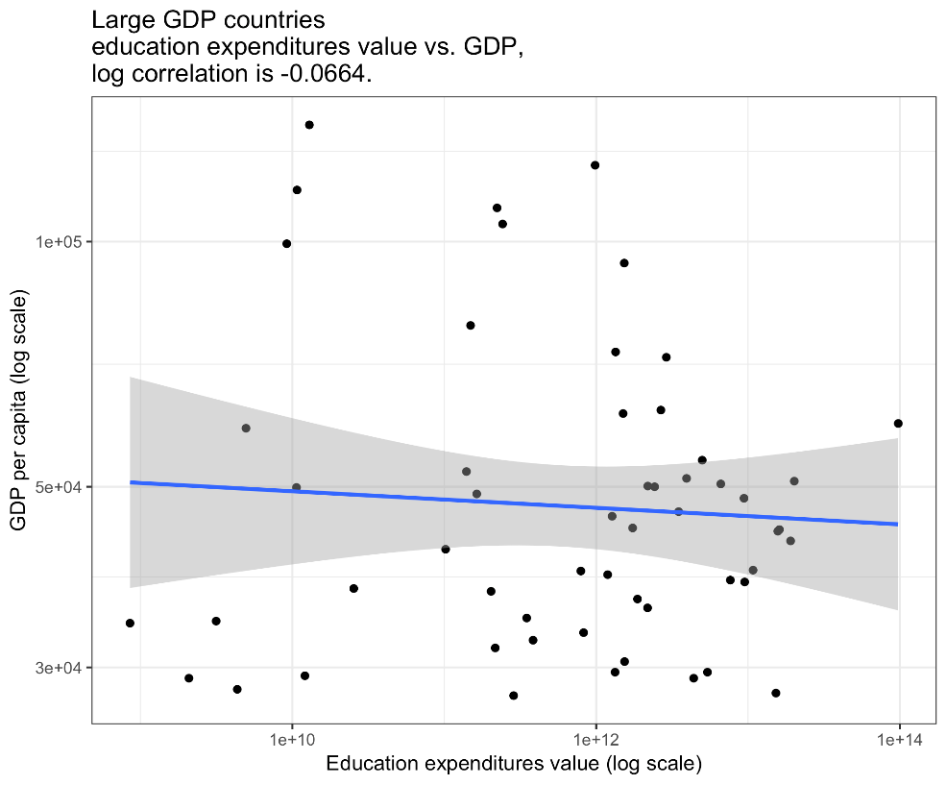
Education expenditure vs. GDP per capital
09
Education expenditure

Slide 44
10
Health expenditure problem revisited
What if we group countries into 3 GDP brackets:
Low GDP countries
Middle GDP countries
High GDP countries
Would correlation matrix look different?

Slide 45

10
Health expenditure problem revisited
Mid-Tier GDP
Countries
Low-Tier GDP
Countries
High-Tier GDP
Countries
Life expectancy
Median age
HIV/AIDs adult
prevalence rate
Obesity adult
prevalence rate
Children (<5 yrs)
underweight rate
Maternal mortality rate
Infant mortality rate
Total fertility rate

Slide 46
AGENDA
01
Introduction
02
Web Scraping
03
Topic 1: People and Health
04
Topic 2: Education, Communication and Economy
05
Conclusion and Wrap Up
Notes:
© Copyright Showeet.com

Slide 47
Thank you!

